Slide 1
Flex Day
April 21, 2022

Slide 2
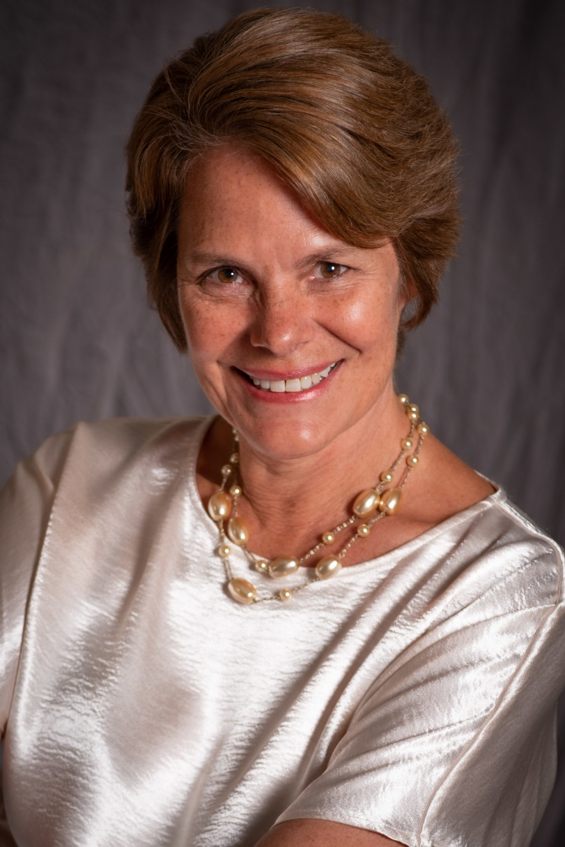
President’s Welcome
Kim Lopez
College President

Slide 3
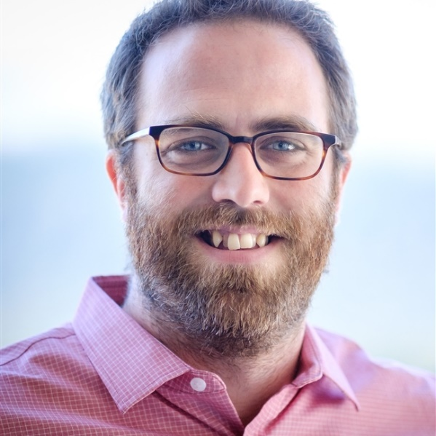
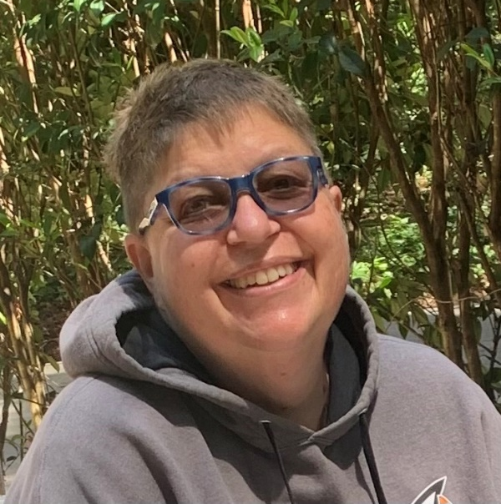
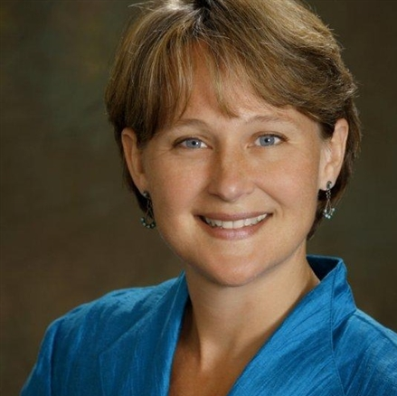
Educational Master Planning Update
David Eck Academic Senate President Professor, Philosophy | Roslind Young Classified Senate President Laboratory Coordinator | Karen Engel Dean of Planning, Research, Innovation & Effectiveness (PRIE)
Tri-Chairs, Educational Master Planning Task Force 2021-22

Slide 4
Educational Master Planning Process & Timeline
PBC names EMP Task Force Members
EMP Task Force evaluates 2017-22 EMP
SCUP Training in Strategic Planning
Mission, Vision, Values Update
Educational Master Plan Timeline
EMP TF considers “Internal Scan”
EMP TF considers “External Scan”
College Councils provide input on challenges and opportunities
Town Hall
Winter 2021
Spring 2021
September 2021
October 2021
EMP Retreat: Set goals and new strategies
Campus constituents provide input on draft EMP
PBC considers draft EMP
PBC adopts new EMP for 2022-27
October 2021
November 2021
December 2021
February 2022
February 2022
March 2022
April 2022
May 2022

Slide 5
THANK YOU to our EMP Task Force!
Faculty Members:
Humanities and Social Sciences Division Rep: Alicia Aguirre
Business, Design and Workforce Division Rep: Leonor Cabrera
Science and Technology Division Rep: NA
Kinesiology, Athletics and Dance Division Rep: Eddy Harris
Counseling Division Rep: Jenna French
Student Representatives:
Mira Rubio
Brittney Samora-Delgadillo
Classified Staff Representatives:
Outreach & Welcome Center Rep: Jeanne Stalker
Classified Rep At Large (and GP Success Teams): Nimsi Garcia
Transfer Services Rep: Mary Ho
Instructional Division Rep: Krystal Martinez
Instructional Technologist: Allison Hughes
Administrators:
Dean of Business, Design & Workforce: Hyla Lacefield
Dean of Enrollment Services and Student Support: Wissem Bennani
Staff Support:
The Office of Planning, Research & Institutional Effectiveness will provide staff support, research, analysis and writing throughout the process:
Dr. Alex Claxton
Dr. Milena Angelova
Olisaemeka Chukwudebe (student assistant)

Slide 6
New EMP Draft
Our final draft of our Educational Master Plan (2022-27), including updated Mission, Vision and Values Statements, is available online here:
https://canadacollege.edu/emp/missionvisionvaluesdraft.php

Slide 7
Proposed New College
Mission
Cañada College engages and supports students in transforming their lives and communities through education.
Cañada College engages and empowers students in transforming their lives and communities through quality education.
Cañada College inspires life transformation and community engagement through quality education.

Slide 8
Proposed New College
Vision
Cañada College provides quality, equitable education that inspires and empowers students to achieve their goals and benefit the world.

Slide 9
Proposed New College
Values Statements
Social Justice and Racial Equity
Antiracism
Equity
Inclusion
Diversity
Access
Transforming Lives
Community Partnerships
Academic Excellence
Sustainability
Transparency and Authenticity
Adaptability and Resilience
Student-Centered
Cultural Empathy
Draft values statements can be found on the Ed. Master Planning website here: https://canadacollege.edu/emp/missionvisionvaluesdraft.php

Slide 10
Proposed New College
Goals
Student Access, Success and Completion
Cañada College ensures student access to relevant and transformative student services and instructional programs that are inclusive, diverse, equitable, and antiracist. As an institution, Cañada contributes to the financial stability of students to empower them to pursue personal, academic, professional, and civic goals. Cañada College continuously assesses processes and removes barriers to student access, success, and completion.
Community Connections
Cañada College establishes equity-minded partnerships with other educational institutions, employers, governments, and community-based organizations that result in seamless pathways for high school students transitioning to college, college students transitioning to university, and all community members pursuing career, and lifelong educational opportunities.
Equity-Minded and Antiracist College Culture
Cañada College transforms its culture to be equity-minded and antiracist. Our teaching, learning, and services create a sense of belonging among all community members so they are able to recognize that their unique selves are valued, express themselves fully, and thrive. Our educational practices reflect the fundamental importance of individualized learning experiences, the shared building of knowledge, and promoting social justice at Cañada College.
Accessible Infrastructure and Innovation
College financial resources are well managed in support of the College’s values and to provide accessible physical and virtual spaces that promote continuous innovation and excellence in teaching and learning. Cañada’s investments in physical, technological and transportation infrastructure create equitable access to the College and support equitable educational outcomes across the diverse members of the community we serve.

Slide 11
Feedback Received & Addressed
Student Services Planning Council – April 13, 2022
Academic Senate – April 14, 2022
Classified Senate – April 14, 2022
Associated Students of Cañada College – April 14, 2022
Instructional Planning Council – April 15, 2022
College Flex Day – April 21, 2022
Planning & Budgeting Council – May 4, 2022
Planning & Budgeting Council – May 18, 2022

