Slide 1

Emergency Transition to a Virtual Campus:
Student Survey
Office of Planning, Research & Institutional Effectiveness
&
Welcome Center Team
April 10, 2020

Slide 2
Survey Validity
23% response rate
942 out of 4,135 students
Sample is representative of our overall student body
  Male students are under-represented

Slide 3
Q1 - How would you rate your recent experience transitioning to online instruction?

Slide 4
Q1 - How would you rate your recent experience transitioning to online instruction?
Low income students were more likely to experience the transition as “very” or “somewhat” challenging

Slide 5
Q2 - Do you have access to:

Slide 6
Q3 - What is your primary way of accessing online instruction?

Slide 7
Q4 - Are you worried about running out of data on your cell phone?

Slide 8
Q5 - In addition to your professors, are you in touch with other college staff?

Slide 9

Q6 – Please let us know who is supporting you to be successful online (name of college staff person or program)

Slide 10
Q7 - The College would like to make sure you have everything you need to be successful online. What’s the best way for college staff to contact you?

Slide 11
Q9 - Are you considering withdrawing from any of your classes this semester?

Slide 12
Q10 - If instruction remains primarily online due to the Pandemic, are you likely to enroll in classes this Summer?

Slide 13
Q11 - With the Shelter in Place order, please let us know your level of concern about the following in terms of your being able to complete the semester?

Slide 14
Free Response Summary
Requiring concurrent attendance is difficult for those with family
Even those who were online before are having trouble
There is a general concern about lab courses and getting the practical experience
Students are unsure about how they can access student services
The most common concern is resource (money).

Slide 15
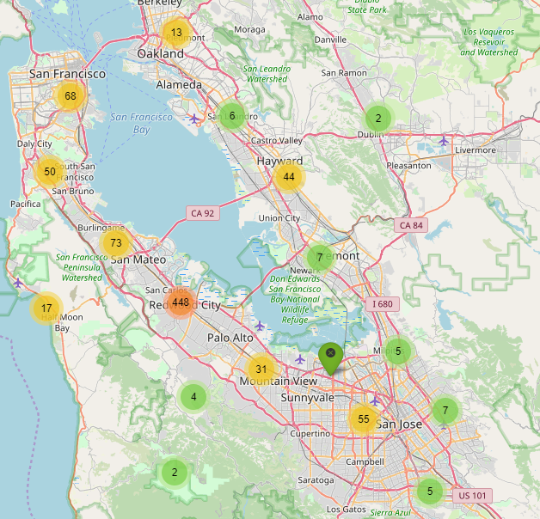
Map of respondent locations

Slide 16
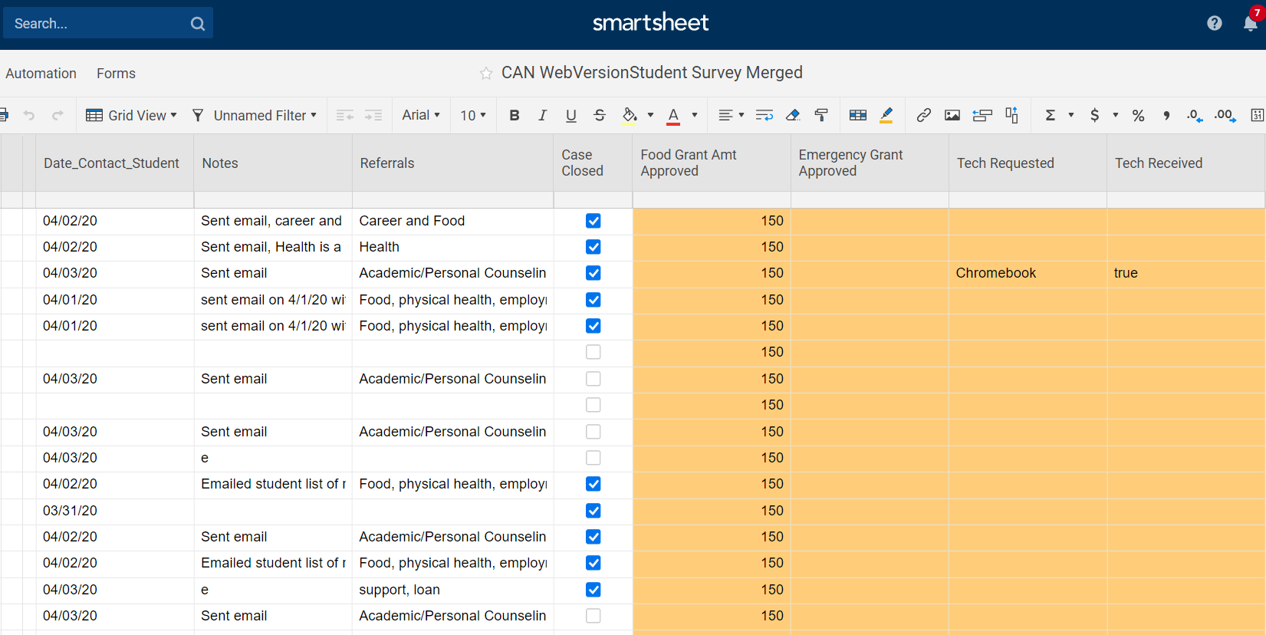
Welcome Center One-on-One
Follow-Up with Students

Slide 17
Thank you!
These results are posted on the PRIE website
https://canadacollege.edu/prie/

