Slide 1

Summary of Spring 2019 SEM Findings
May 8, 2019
Revised for presentation to PBC on May 15, 2019

Slide 2
Members of the SEM Committee
Tammy Robinson, VPI, co-chair
Karen Engel, Dean, PRIE, co-chair
Hyla Lacefield, Academic Senate President
Diana Tedone-Goldstone, Librarian, Academic Senate VP
Jeanne Stalker, Classified Senate President
Lezlee Ware, Distance Education Coordinator, Faculty
Paul Naas, CE Faculty
Marisol Quevedo, Promise Program Coordinator
Mayra Arellano, College Recruiter
Ruth Miller, Registrar and Admissions
Char Perlas, VPSS
Max Harman, Dean of Counseling
James Carranza, Dean, H&SS
Adam Windham, Dean, STEM
Leonor Cabrera, Dean, BDW
David Reed, Dean, ASLT
Marketing and Community Relations (Dave McLean and Megan Rodriguez-Antone
President Jamillah Moore
Graciano Mendoza, VPA

Slide 3
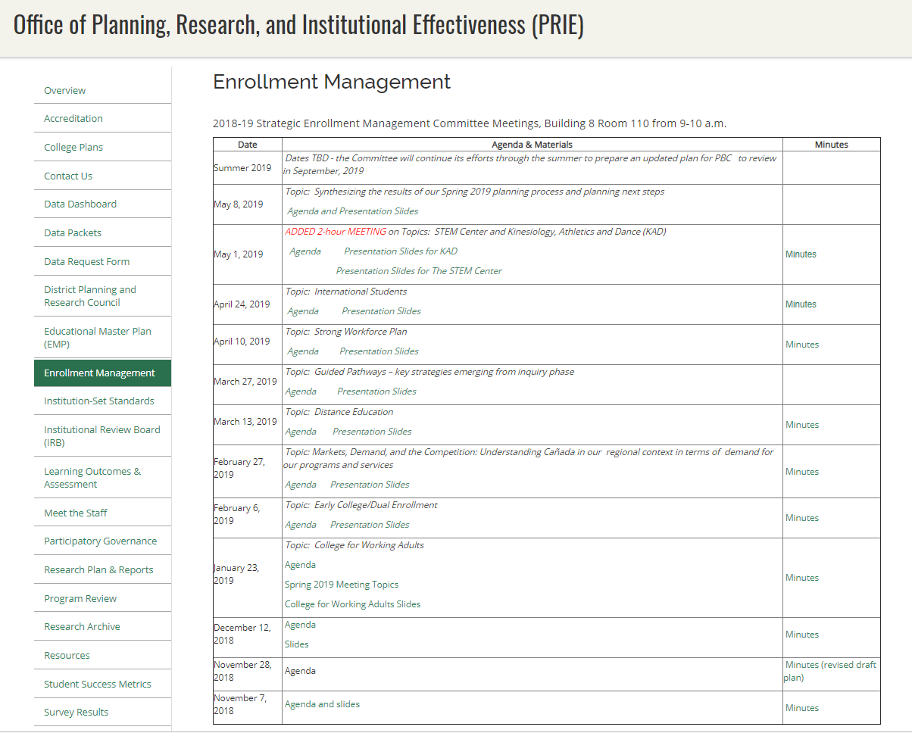
All meeting materials and data posted on the PRIE website: https://canadacollege.edu/prie/enrollmentmanagement.php

Slide 4
Contents
What is the data telling us?
What did we learn about the programs and topics we explored?
What questions remain?
Synthesis and emerging recommendations

Slide 5
Headcount: down 4.6% in 5 years

Slide 6
FTES: down 16% in 5 years

Slide 7
Average face to face units taken: down 54% in 5 years
Average online units taken: down 38% in 5 years
 | Hybrid |  | Face to Face |  | Online
 | % of Enrollments | Average Units | % of Enrollments | Average Units | % of Enrollments | Average Units
2017-18 | 14% | 9.0 | 63% | 8.8 | 23% | 4.8
2016-17 | 14% | 8.7 | 67% | 9.3 | 19% | 4.6
2015-16 | 14% | 8.3 | 70% | 9.4 | 16% | 4.3
2014-15 | 12% | 8.5 | 72% | 9.2 | 16% | 4.3
2013-14 | 12% | 17.5 | 75% | 18.7 | 13% | 8.1
2012-13 | 12% | 17.5 | 78% | 19.0 | 10% | 7.8
Includes only students who enrolled in the respective course modality
Average Total Units Enrolled Per Student Per Academic Year

Slide 8
Major Demographic Shift: County population is getting older
Cañada’s share of college-age residents has remained the same
 | 2013 | 2014 | 2015 | 2016 | 2017
San Mateo County Population Ages 18-35 | 168,589 | 168,746 | 167,426 | 165,591 | 164,205
Cañada Students (unduplicated) | 11,446 | 11,695 | 11,641 | 11,278 | 10,947
Share | 7% | 7% | 7% | 7% | 7%

Slide 9
Enrollment management in the age of resource constraints…

Slide 10

Enrollment management in the age of resource constraints…
more enrollment
more resources

Slide 11
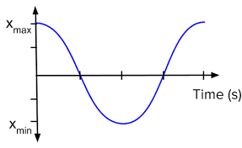
Enrollment management in the age of resource constraints…
simple harmonic motion

Slide 12
Enrollment management in the age of the completion agenda…

Slide 13
Enrollment management in the age of the completion agenda…
Recruitment
Persistence
Completion

Slide 14
Enrollment management in the age of the completion agenda…
Recruitment
Persistence
Completion
START Strong
STAY Strong
FINISH Strong

Slide 15
Recruitment: 66% down to 34%??

Slide 16
Persistence
 | Fall to Spring Persistence Rate 2018-19
College for Working Adults | 91%
STEM Center | 89%
Promise Scholars | 88%
First time full time students | 83%
Canada “home” campus students only | 63%
College Overall | 57%

Slide 17
Completion
 | 2013-14 | 2014-15 | 2015-16 | 2016-17 | 2017-18
Degree completion | 422 | 463 | 486 | 585 | 558
Transfer | 260 | 293 | 276 | 307 | 341
Certificate completion | 400 | 332 | 244 | 292 | 372
TOTALS | 1,082 | 1,088 | 1,006 | 1,184 | 1,271
Duplicated data

Slide 18
Top Majors Declared 2013-18
Top Majors (2013-18) | Students | Completers in 2018
Undeclared Major AA/AS Degree | 4,002
Business - Administration (2884) & Mgmt (539) | 3,423 | 50
Education and Human Development | 2,070 | 86
Psychology | 1,989 | 46
Computer Science | 1,235 | 14
Engineering | 1,143 | 10
Allied Health | 964 | 33
Fashion | 923 | 23
Kinesiology | 882 | 8
Nursing | 860 | 0
English | 831 | 5
Biology | 826 | 10
Accounting | 815 | 10
General Liberal Arts & Science | 691 | 0
Medical Assisting | 653 | 27
Radiology Technology | 588
Multimedia Art | 586 | 14
Interior Design | 581 | 63
Sociology | 537 | 27
Administration of Justice | 475 | 0

Slide 19
Regional Share of FTES
College | Business & Management | Information Technology
Canada | 84% | 59%
DeAnza | 107% | 140%
Foothill | 131% | 113%
San Francisco | 58% | 78%
San Mateo | 150% | 150%
Skyline | 83% | 20%

Slide 20
Topics Explored
College for Working Adults
Dual Enrollment and Middle College
Online Education
Career Education
International Students
KAD and the new Building 1
STEM Center Innovations

Slide 21
College for Working Adults (CWA)
250 students with above average completion rates
Cohort Scheduling: classes are offered at specific times
Wrap-around services (counselor; tutors (2) graduates of the program who are embedded who also serve as TA’s); may add a third psychology tutor)
Communication: Canvas class for the CWA community
  Students can communicate with each other and the program;
  Announcements posted there;
  Calendar is posted there for tutor sign-ups

Slide 22
Dual Enrollment
168 dual enrollment students
107 Middle College
762 other concurrent enrollments
Students with early college experience have better outcomes:
  More likely to enroll in college
  Higher course success rates
  Greater program completion rates
Goal: Increase college and career exploration opportunities for student from feeder high schools
 |  | San Mateo CCD |  | College of San Mateo |  | Canada College |  | Skyline College
High School Graduating Years | Total Public High School Graduates in San Mateo County | High School Graduate Enrollment | Take Rate | High School Graduate Enrollment | Take Rate | High School Graduate Enrollment | Take Rate | High School Graduate Enrollment | Take Rate
2008/09 – 2012/13 | 28,693 | 15,594 | 54% | 7,693 | 27% | 5,040 | 18% | 8,736 | 30%
2009/10 – 2013/14 | 29,395 | 14,379 | 49% | 6,809 | 23% | 4,299 | 15% | 7,884 | 27%
2010/11 – 2014/15 | 29,747 | 14,078 | 47% | 7,082 | 24% | 4,742 | 16% | 8,018 | 27%
2011/12 – 2015/16 | 29,951 | 13,701 | 46% | 7,142 | 24% | 4,851 | 16% | 7,734 | 26%
2012/13 – 2016/17 | 30,313 | 13,503 | 45% | 7,271 | 24% | 4,932 | 16% | 7,681 | 25%

Slide 23
Online Education: FTES by Instructional Modalities
2012-13
2017-18

Slide 24
Online Education
Online enrollment is increasing, while face to face is declining
Divisions and departments to follow clearer guidelines when deciding what to offer online
Committee recommendations re college values for online ed:
  Make scheduling decisions and whether to offer a course online with (different types of ) student needs and related data in mind
  Always preserve face-to-face options as much as possible
  We don’t want to be an online college – we want to ensure students have options in their learning modalities
We have equity issues: access and course success
We must provide online student supports (Net Tutor, etc.)
We much require faculty teaching online to participate in online teaching pedagogy training regularly

Slide 25
Career Education
Headcounts are consistently 3,500+
Flagship “design” and Education programs are a known draw for the campus
Growth and innovation of programs is critical
Need a greater presence and course offerings downtown
Marketing programs is a major effort that needs ongoing support
Early exposure to “design” or careers for youth and career changers needs to be scaled
Partnerships with 4-years could help bring some BA courses to campus & deepen pathway (SEM Committee supports exploration of partnerships with SJ State (Digital Art) and SF State (ECE))
Partnerships with employers are critical but faculty can only do so much…
Campus alignment and strengthening of relationships with employers and expansion of job shadowing, internships, job placement functions across Divisions and with the Career Center is critical

Slide 26
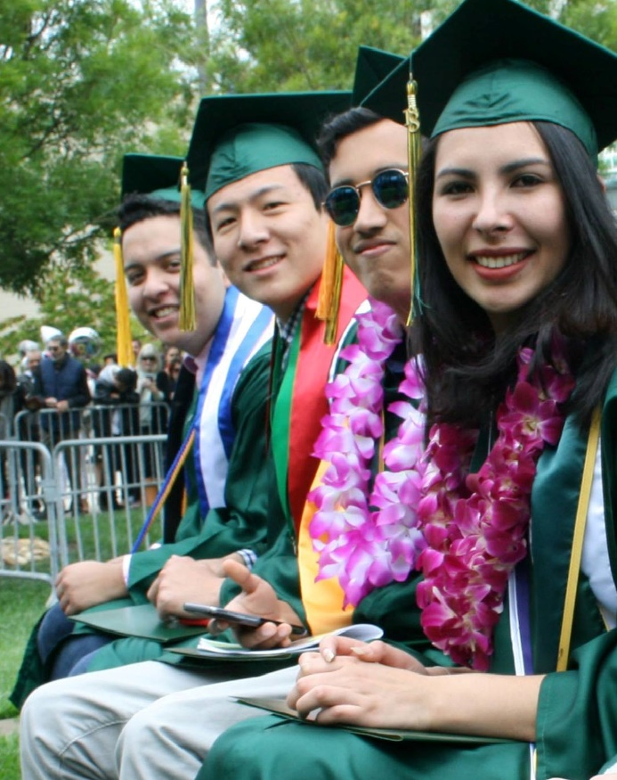
International
136 students per year now – can grow!
Target markets: Au pairs, SVIEP students, families in the local area
Major reasons students come: our programs (design, STEM); our location in Silicon Valley; our small size and personal attention
Challenges: our name (confusion)
Opportunity: Hybrid program: students do year 1 online from their home and year 2 here on campus

Slide 27

Kinesiology, Athletics, Dance (KAD)
1,116 current headcount (KAD)
Headcounts have fallen by 36% over the last five years:
  Repeatability rule change impacted FITNESS enrollments
  Lack of facilities (now)
Student outcomes are all above average
Program provides aligned counseling, regular progress reports, information via workshops, creates culture of “belonging”
Great opportunities exist with the new building, but how can we afford to invest in new faculty, coaches and programs?

Slide 28
STEM Center
886 students participated in STEM activities in 2017-18
Higher persistence rate: 89%
Programs include many “best practices” also indicated by CUNY-ASAP and Guided Pathways:
  Career exploration
  Retention specialist and aligning counseling support
  Cohorting, events, and the physical location of the STEM Center create a sense of belonging
  Supplementing Instruction: EPIC, tutoring

Slide 29
These programs (CWA, STEM, Athletes, Promise) have things in common:
Students are in a cohort or in a defined program with peers
Counselor(s) are aligned with and highly knowledgeable of the program and its requirements
Success Teams: Counselors, Retention Specialists work together
Student level data is reviewed regularly (SEPs +) and students monitored and kept informed re what they need to do to achieve their ed. goals
Supplemental Instruction (EPIC; minimum tutoring expected)
Students are encouraged to attend full time (12-15 units/term)
Instructional faculty are aligned with the program – offering contextualized support
Career exploration and development is baked in to the student journey

Slide 30
Guided Pathways – QFE Action Items
Complete-ability
Increased accuracy of Student Education Plans which can inform course scheduling
Grouping degree programs into ‘Interest Areas’ or ‘Meta Majors’
Optimization of the class schedule to avoid class cancelations and conflicts
Alignment of support services with interest areas
Implementation/expansion of various high school engagement strategies: Dual Enrollment, Summer Programs, Outreach Events, etc…
Modification of the current Priority Enrollment Program (PEP) to better serve incoming students

Slide 31
Guided Pathways – QFE Action Items cont…
Expansion of cohorts via learning communities
Expansion of Support (including Job Placement and Career assistance) and Instructional Programs
Identification of job placement data tool
Streamlining the application process
Providing the needed support for FAFSA completion
Development of a First Year Experience program
Development of Bridge Programs

Slide 32
SEM Committee Recommendations
Continue working on the plan and key performance indicators over the summer resulting in a draft SEM Plan submitted to PBC in early fall 2019
Get clearer on the distinction between the Strategic Enrollment Management and strategic initiative planning and implementation generally
A new task force for aligning outreach has been formed, with Mayra Arellano in the lead which will also meet over the summer and consider:
  How to best coordinate all of the outreach activities and contacts currently happening to maximize impact and be more efficient – resulting in a Campus-wide Outreach Plan by end of summer
  What the key messages are about the College and to which audience(s)
  How the College could conduct a thoughtful process for considering whether or not to pursue changing the College’s name

