Slide 1

Annual Plan
2018-19
DRAFT as of November 2, 2018

Slide 2
The College Annual Plan
Sets forth the activities to be implemented in one year to support the achievement of the five-year goals articulated in the Education Master Plan, which are in support of achieving the College Mission.
Is a synthesis of objectives, strategic initiatives, and activities of other college plans, grant deliverables, and recent mandates from the State Chancellor’s Office.

Slide 3
College Mission
Mission
Programs
Budgeting
Provide our community with a learning-centered environment, ensuring that all students have equitable opportunities to achieve their transfer, career education, and lifelong learning educational goals. The college cultivates in its students the ability to think critically and creatively, communicate effectively, reason quantitatively, and understand and appreciate different points of view within a diverse community.

Slide 4
Education Master Plan
College Mission
Goal 1:
Student Completion
Goal 2:
Community Connections
Goal 3:
Organizational Development

Slide 5
Goal 1: Student Completion Desired Outcomes | Action Steps to be Implemented in 2018-19 | Timeline | Responsible Parties | Planning Council Lead | Resources
Clarify Academic Pathways | Explore whether creating meta majors (interest areas) would improve student outcomes |  |  | IPC
 | Evaluate the course schedule with respect to time-to-completion for the top 20 degree and certificate programs |  |  | IPC
 | Enhance and expand distance education strategically |  |  | IPC
Identify and address business process barriers | Scale the Promise Program and evaluate Promise student experiences to help address barriers caused by enrollment fees, cost of textbooks, parking fees, transportation, child care, food and housing insecurity. |  |  | SSPC
 | Adopt a transcript evaluation process to help incoming students maximize units |  |  | SSPC
 | Streamline the matriculation process |  |  | SSPC
Improve pre-transfer student outcomes | Create new co-requisite English and math courses |  |  | IPC
 | Create systems to allow all students' high school transcript data to be considered in placement |  |  | SSPC
 | Create and align new instructional supports (e.g., embedded tutoring, a Writing Center) to support pre-transfer level students |  |  | IPC/SSPC
Expand and extend cohort bridge programs to students beyond their first year of study. | Institutionalize STEM Center innovations |  |  | SSPC/IPC
 | Scale STEM Center Innovations |  |  | SSPC/IPC
 | Plan for scaling First Year Experience programs for first-time students |  |  | SSPC/IPC

Slide 6
Goal 2: Community Connections Desired Outcomes | Action Steps to be Implemented in 2018-19 | Timeline | Responsible Parties | Planning Council Lead | Resources
Increase the number of high school students successfully transitioning to Canada | Increase dual enrollment opportunities |  |  | IPC/SSPC
 | Expand Middle College |  |  | IPC
 | Utilize articulation agreements effectively |  |  | IPC
 | Create new career education pathway programs |  |  | IPC
 | Enable earlier career exploration opportunities for high school students |  |  | IPC
 | Scale enrollment in online course for career exploration and preparation |  |  | IPC/SSPC
 | Train faculty and staff to support student career placement |  |  | IPC/SSPC
Build infrastructure for career exploration and job placement | Create an online portal for employers to connect with students and faculty |  |  | IPC (BDW)/SSPC
 | Complete mapping CE skills to industry approved digital badges and enable the link between these and student LinkedIn and other professional network sites |  |  | IPC/BDW
 | Complete the re-branding of CE programs that is in process |  |  | APC/BDW
 | Host alumni showcases, speaker series, and other industry events to expose students to career information and insights |  |  | APC/BDW
 | Strengthen the CE alumni network via LinkedIn and other professional networks |  |  | APC/BDW
Host high profile signature events | Successfully launch the President's Annual Luncheon |  |  | APC
Expand and enhance 2+2 relationships with 4-year universities | Institutionalize STEM Center innovations |  |  | SSPC/IPC
 | Re-launch the University Center |  |  | IPCSSPC

Slide 7
Goal 3: Organizational Development Desired Outcomes | Action Steps to be Implemented in 2018-19 | Timeline | Responsible Parties | Planning Council Lead | Resources
Implement the Professional Learning Plan to support student success and promote equity. | Update provisional 2017-18 plan and develop new, 2019-2022 plan |  |  | IPC
Implement Guided Pathways-like design principles to help address equity gaps. | Clarify Academic Pathways (see Goal 1) |  |  | IPC
 | Facilitate Career Exploration (see Goal 2) |  |  | IPC/SSPC
 | Identify and address business process barriers (see Goal 1) |  |  | SSPC
 | Align the Strategic Enrollment Plan strategies with those emerging from the Guided Pathways work |  |  | APC/PRIE
Institutionalize effective structures and best practices of HSI in order to reduce the achievement gap. | Institutionalize effective practices as part of the Guided Pathways work (see Goal 1) |  |  | SSPC
Update and implement Facilities Master Plan | Collaborate with the District to update Plan |  |  | APC
 | Complete new buildings (1 and 23); renovate building 9 with minimum impact on students and staff |  |  | APC
Integrate planning and resource allocation process | Implement PBC-approved changes to program review timeline and processes |  |  | APC
Improve participatory governance process (and update Manual) | PBC Governance Work Group to review and update |  |  | APC
Maintain accreditation status | Complete Institutional Self-Evaluation Report and identify top priority projects for Quality Focus Essay |  |  | APC/PRIE

Slide 8
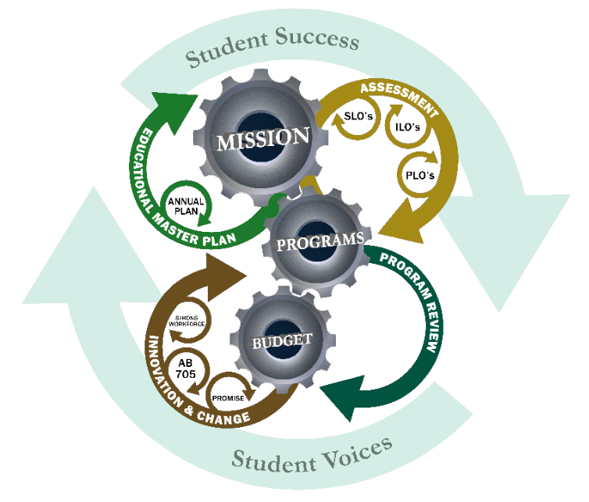

Slide 9
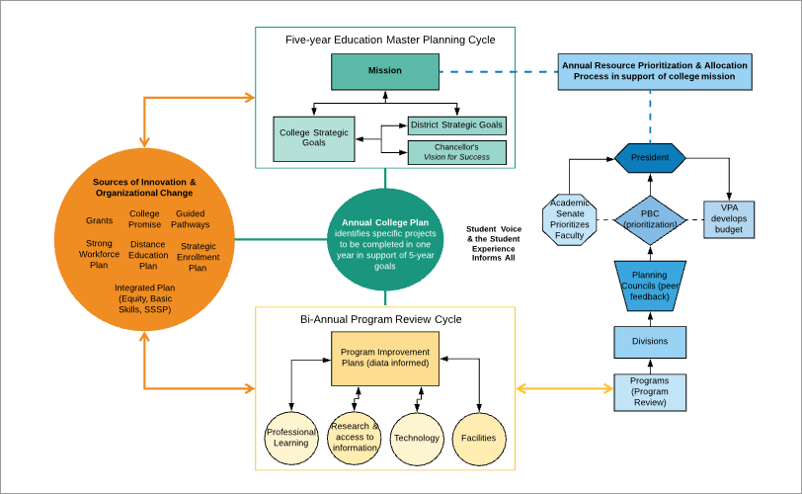

Slide 10
College planning calendar
Year: 2017 2018 2019 2020 2021 2022 2023 2024 2025 2026 2027
ISER 2019
Mid-Term Report
ISER 2026
ACCJC Annual, Mid-term, and ISER Report Cycle
5-year Education Master Plan Cycle
5-year Education Master Plan Cycle
Annual Plan
Annual Plan
Annual Plan
Annual Plan
Annual Plan
Annual Plan
Annual Plan
Annual Plan
Annual Plan
Annual Plan
Distance Education Plan
Facilities Master Plan
Guided Pathways Plan
Integrated Plan
Professional Learning Plan
Research Plan
Strategic Enrollment Plan
Strong Workforce Plan
Sustainability Plan
Technology Plan

Slide 12
Appendix A:
Program Goals & Objectives
2017-18 Program Review

Slide 13
Program | College Goal 1 Student Completion & Success | College Goal 2 Community Connections | College Goal 3 Organizational Development
Academic Support & Learning Technologies Division
Distance Education | Enhance and expand distance education Staff the ELITE program |  | Re-open CIETL Train faculty to improve quality and effectiveness of SLO assessments
Learning Center | Improve online presence Work collaboratively (across the college and with partners) to improve student success and retention Help create a Writing Center and support writing across the curriculum
Library | Increase access to textbook reserves Increase streaming films offerings to meet faculty and student demand. Support equity by increasing access to the internet for students without a connection at home. Meet demand for easy "all-in-one" search box for library resources and cut cost of EBSCO Discovery Work with Learning Center to provide workshops on technology such as Chromebooks, Canvas, and Google Drive Provide students help with sign up for, navigating, and using Canvas Provide students help with using course required technology such as SNAP, Math Lab, etc. Provide online reference help Create self-guided Canvas modules on information competency for instructors to use in their classes. Create more videos explaining information competency concepts such as in-direct quotations, finding original research in the sciences, APA citation, etc. Increase student study space Survey students on research habits Focus group on Library Space Survey instructors on usefulness of library orientations for Basic Skills and ESL. Survey students on use of regular textbook reserves Survey former LIBR 100 student to see if their library use increased and what research skills they sued in other classes.

Slide 14
Program | College Goal 1 Student Completion & Success | College Goal 2 Community Connections | College Goal 3 Organizational Development
Business, Design & Workforce Division
Accounting & Business Administration | Invigorate course enrollments and raise the visibility of accounting and business on campus | Offer workshops, SCORE assistances, and business start-up assistance
Architecture
Computer Business Office Technology | Part of Business Accounting Technology (BAT)
Cooperative Education
Digital Art and Animation (Multimedia) | Adapt to industry requirements - game level design, vr design, expanding existing courses such as character animation and modeling & UI/UX | Recruit new students with help of Marketing Department Track alums as they work in industry
Early Childhood Education/Child Dev.
Economics
Fashion Design and Merchandising | Train new assistants that have been hired so that recruitment and retention continue in the department. Continue to give as many scholarships as possible (via Artistry in Fashion). Continue to offer creative contest opportunities Work closely with district Study Abroad by offering a summer class in Italy. | Market the program in new ways especially through social media. Offer new and diverse special events that bring students to the program. Special speakers and luncheons offered throughout the year. Add one new member to the Advisory Board
Human Services | Pursue merger with ECE program Identify positions and skills in the Human Services field where there is increased employment demand and incorporate these skills into our course offerings. Complete in-depth analysis of SLOs and PLOs to date to enhance course outcomes. | Expand and enhance HMSV Advisory Board Pursue partnerships in the community to enhance internship offerings.
Interior Design | NOTE: these are not goals or objectives: Review the articulation status with SFSU Continue funding for NKBA Accreditation Combine the data packets for ARCH and INTD into one Revision of the class size maxima. Program Coordinator reassigned time | Work with the design community to build new partnership Plan fundraising events to support our program

Slide 15
Program | College Goal 1 Student Completion & Success | College Goal 2 Community Connections | College Goal 3 Organizational Development
Business, Design & Workforce Division
Medical Assisting | Marketing & Outreach Create a physical front office simulation station Updating industry standard software including MediSoft and ExpressScribe Updating any annual code changes for medical coding and billing in existing curriculum Exploring online interactive text options for students Implement Electronic Scribing while Performing Clinical Skills into Curriculum
Paralegal | Address declining enrollments by: Establish the Director of Workforce Development as the Interim Coordinator for the Paralegal program. Work with the Faculty Coordinator of Skyline’s program to develop integrated scheduling that meets student needs. (One option) Work with the faculty leaders in Business, Accounting and Technology to incorporate the Paralegal program as part of the BAT program. (Another option) Use labor market and enrollment data to identify gaps in the market and respond to student needs. Do long term schedule planning that increases access and addresses the needs of JobTrain and Adult School students. Communicate with counselors about the program’s current and future direction. Work with the Dean and the college Budget Office to ensure that Paralegal faculty schedule planning is informed by budget and resource allocations. | Establish a marketing sub-committee to design and disseminate informative marketing collateral. Actively engage with students, advisory board members and external partners to remain current with changing academic and career demands. Grow internship opportunities for students in the Paralegal program

Slide 16
Program | College Goal 1 Student Completion & Success | College Goal 2 Community Connections | College Goal 3 Organizational Development
Kinesiology, Athletics & Dance Division
Kinesiology, Athletics, and Dance | Plan for program expansion in new facility (athletic, dance, and fitness) Create new courses: Dance Appreciation, Swing, Tap Dance, Argentine Tango; Spinning, Survey of Sport, Aquatics, Hiking/Backpacking/Trailing Running, Badminton, Weight Training/Body Conditioning, Volleyball class, Pickleball; First Aid, CPR, AED, Sports Psychology, Sports Management, Stress Management, Lifetime Fitness and Nutrition Maintain effectiveness of current courses and increase new course offerings through equipment, supply, and technology purchases. | Redesign program website Work with California Canine for Independence to house a facility dog

Slide 17
Program | College Goal 1 Student Completion & Success | College Goal 2 Community Connections | College Goal 3 Organizational Development
Humanities & Social Sciences Division
Anthropology | Faculty to stay current (via conferences, courses, literature, travel, etc)
Communications Studies | Communicate better with COMM Majors
Economics | Faculty to stay current (via conferences, courses, literature, etc) | Recruit more students to the program
History | Seeking institutional support for possible new classes or modalities
Philosophy
Political Science
Psychology | Faculty to stay current (via conferences, courses, literature, travel, etc) Improve pedagogical effectiveness through class teaching technology
Sociology | Coordination time for the social sciences remains problematic.The college needs to decide if it wants finance the SSs to do things beyond teaching classes and keeping curriculum current
Art & Art History | Design 2 new Art History classes Plan new course in Museum Studies Plan for Guided Pathways |  | We could like to create a separate and larger area for students to store artwork they are working on in class. Accelerate the process of digitizing the slide collection for the future

Slide 18
Program | College Goal 1 Student Completion & Success | College Goal 2 Community Connections | College Goal 3 Organizational Development
Humanities & Social Sciences Division
English | Assess new placement procedures Develop faculty-led tutor training Develop Writing Center Reinvigorate Literature Program Continue to institutionalize our faculty-led tutor training
English as a Second Language | Pilot online support workshops Create more pathways for students (with other depts as well as ACCEL partners) Help embed career exploration across disciplines | Continue Career and Majors Event for all ESL students | Permanent Stable Funding for ESL Coordinator and Retention Specialist Pathways and Career Exploration
Latin American Studies | Collaborate with CSM Ethnic Studies to recruit students for ETHN 101 and ETHN 300 Continued support for and cooperation with Puente and ESO Adelante | Continued support for the Cañada Dream Center
Music | Create a mariachi ensemble on campus Maximize enrollment capacity in Piano Lab Replacement Headphones for Piano Lab | Organize more student, faculty and guest performances on campus
Spanish | Keep offering all courses in the sequence
Theater Arts | Offer DRAM 101 in Spring 2019 (expand offerings) Develop Screenwriting Course Participate in Honors Certificate Service and Repair of Main Theater Fly/Rigging System

Slide 19
Program | College Goal 1 Student Completion & Success | College Goal 2 Community Connections | College Goal 3 Organizational Development
Science & Technology Division
Astronomy | Stabilize section offerings, increase retention and completion rates, and strive towards increased section offerings.
Biological & Health Sciences | Improve access and completion for underrepresented students in BIOL (with ACES and STEM/MESA) Create a Neurodiagnostic Associate’s Degree program Develop customized physiology labs The accompanying supplies and equipment are needed to ensure integrity of our instructional curriculum, to foster a conducive learning environment, and to ensure student success in our courses.
Chemistry | To provide the technology to support instruction for all types of learners.
Computer Info Science
Earth Sciences
Engineering | Engineering Lab Software
Mathematics
Physics
Radiologic Technology

Slide 20
Program | College Goal 1 Student Completion & Success | College Goal 2 Community Connections | College Goal 3 Organizational Development
Student Services
Assessment, Orientation & Registration | Improve office processes and efficiency by archiving and storing prior records electronically, and improve staff ergonomics.
Career Services |  | Recruit more students to the program
Career Courses (IPR)
Counseling | Enhance 'E-Counseling' services- start 'Live-Video Counseling' pilot program |  | Promote health and productivity for Counselors
EOPS, CARE, CalWORKs & FYSI | Replace Educational Equipment Transportation costs are a key element of support that we provide students. This year the College assisted EOPS with $25,000. We would like to respectfully request that this be an on-going support. Last year we were not able to provide assistance during the summer session. When possible, we have supported students with a $75 book voucher, transportation costs and counseling services. Last summer SSSP and ACES were not able provide us with additional funding to support these costs. For many of our students not having EOPS support over the summer meant they were not able to take class(es). EOPS/CARE/CalWORKs/FYSI Student Area Mental Health Peer Mentors & Counselor
ESO Adelante, A2B & University Center

Slide 21
Program | College Goal 1 Student Completion & Success | College Goal 2 | College Goal 3 Organizational Development
Student Services
Financial Aid | Staff Training - Program Administration and Compliance Hourly Financial Aid Assistant Replace Presenter PC for Financial Literacy Lab Laptops - Financial Aid use for inreach and outreach Additional Financial Coaching Office Space Contract with Document Vendor for ADA Compliant Forms |  | Replacement PC for Margie Carrington Installation of video extension cord in Financial Literacy Lab Augment Financial Aid Supply and Duplicating Budget Signage for Promise
International Students | Mental Health Peer Educator
Puente
SparkPoint | Hire a Permanent 1.0FTE SparkPoint Coordinator Professional Development for SparkPoint Staff - including AFC Certification Signage for SparkPoint
Student Life & LD
Transfer Center | Originally, the Transfer Center had 6 computers, however, all were damaged by a water leakage from the ceiling in the Transfer Center and 2 of them were never replaced. Laptop - This is to use at the meetings and to assist students at on and off campus activities.
TRiO, BTO & Vets
Wellness Center | PCC would like to hire a counselor and a peer mentor/educator to support the ever growing demand for counseling services as well as engage in campus outreach while cultivating community referrals. This request is related to the pending Mental Health grant and the requirement therein. DRC-Alternative Media-Support for Students with Disabilities Wellness Center-Re-Configuration

