Slide 1
Strong Workforce Program Overview
Presented to the Planning & Budget Council
November 16, 2016

Slide 2
A Call for More and Better CTE
The Goal
California needs
1 million more
AA, certificates, or industry-valued credentials.
Notes:
SW Initiative spurred out of need to fill almost 2 million “middle skills” job openings by 2025. These job require only some college, or an AA degree.

Slide 3
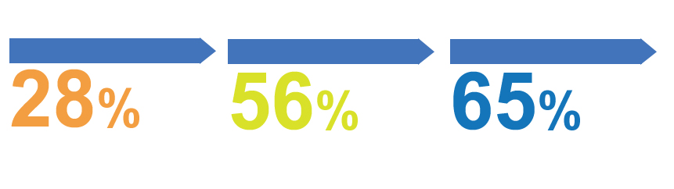
“Some College” is the New Gateway Into The Workforce
THE LABOR MARKET IS INCREASINGLY DEMANDING A MORE SKILLED WORKFORCE.
IN THE 1970s
IN 1992
BY 2020
of jobs required more than a high school education.
of jobs required more training.
of job openings in the U.S. will require some postsecondary education or training-though not necessarily a four-year degree.
Source: Georgetown Center on Education and the Workforce analysis
Notes:
As compared to past years, we can see that our economy is shifting and that new jobs being created require more education.

Slide 4

Focus of SWP is on CTE
Career Technical Education: the Path Out of Poverty
$60,771
($29.22/hour)
2-parent with
one working adult, 2-child
Source: CA Budget Project
$66,000
AA – Career Technical Education
5-years later
Source: Salary Surfer, 112 CA Community Colleges
$38,500
AA - General Education
5-years later
Source: Salary Surfer, 112 CA Community Colleges
Notes:
Focus of SW initiative is on CTE. We can see here that CTE graduates have strong earning potential after only 2 years of education. For comparison, the living wage needed to support a family of 4 is $60k, and a 2-yr CTE degree meets this need.

Slide 5
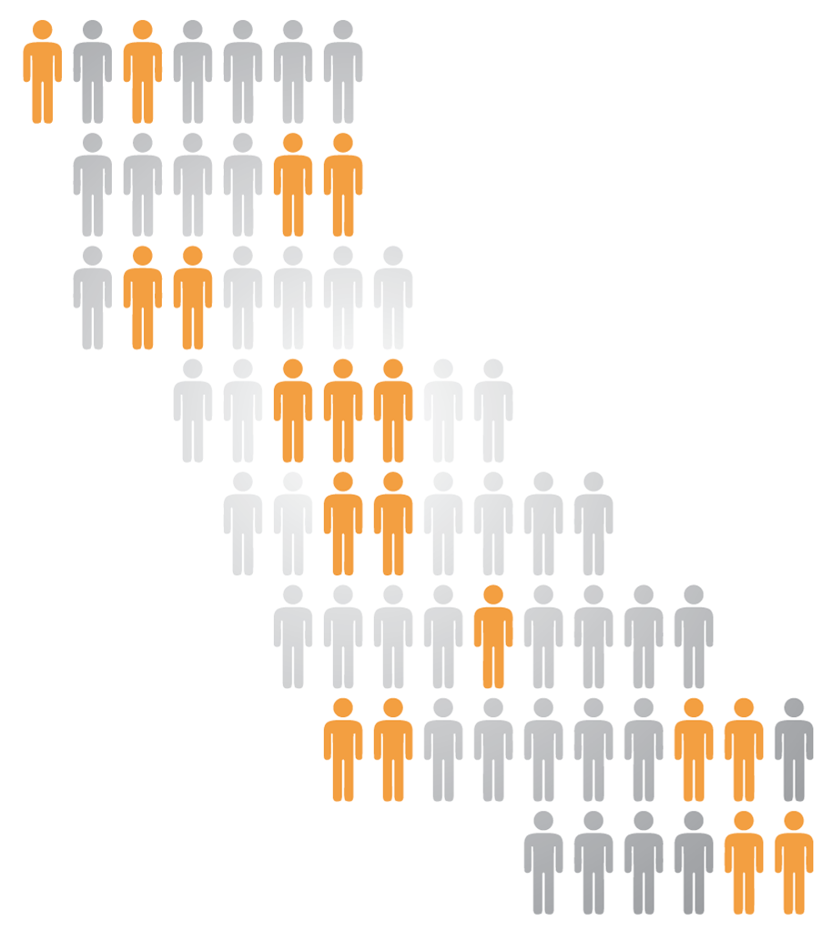
Task Force Roll Out
14 Regional College & Faculty Conversations
    Over 700 attendees, including 40% faculty
6 Strong Workforce Town Hall Meetings
    Over 500 participants in regions across the state
6 expert background papers on common themes
    Workforce Data & Outcomes
    Curriculum Development & Instructors
    Structured Pathways and Student Support (2 parts)
    Regional Coordination
    Funding
5 meetings of the 26-member Task Force
221 website & 10 letters during public comment period
Notes:
In the past, CTE programs have been severely underfunded and frankly, brushed to the side in favoring of supporting other programs. In response to this new data, the Chancellor’s Office moved forward on creating a taskforce to identify pain-points in our system in regard to CTE. This taskforce worked with faculty, students and the community to develop a series of recommendations.

Slide 6
Strong Workforce Taskforce Recommendations
Access all 25 recommendations at: https://goo.gl/XUGV8P
Student Success
Workforce Data & Outcomes
Curriculum
Career Pathways
CTE Faculty
Regional Coordination
Funding

Slide 7
A Call for More and Better CTE
$200M
Ongoing categorical funds
Notes:
In response to our statewide work, the legislature provided support to meet the needs of our students and CTE programs in the form of a commitment of $200m ongoing categorical funds over the next three years.

Slide 8
Focus for the Funds
Increase quantity of CTE
Improve quality of CTE
More enrollments in programs leading to high-demand, high wage jobs
“MORE”
More students complete/transfer
More students employed
More students improving their earnings
“BETTER”
Notes:
FOCUS of these funds “more” and “better.”

Slide 9
Funding Flow
60%
Local Shares
Goes to districts to invest in CTE at colleges
40%
Regional Shares
Invests in CTE at colleges
upon coordinated action
Funds are ongoing and have been allocated to districts based on a labor market need, enrollments, and student outcomes, rather than putting out an RFP.

Slide 10
State Allocation Model

Slide 11
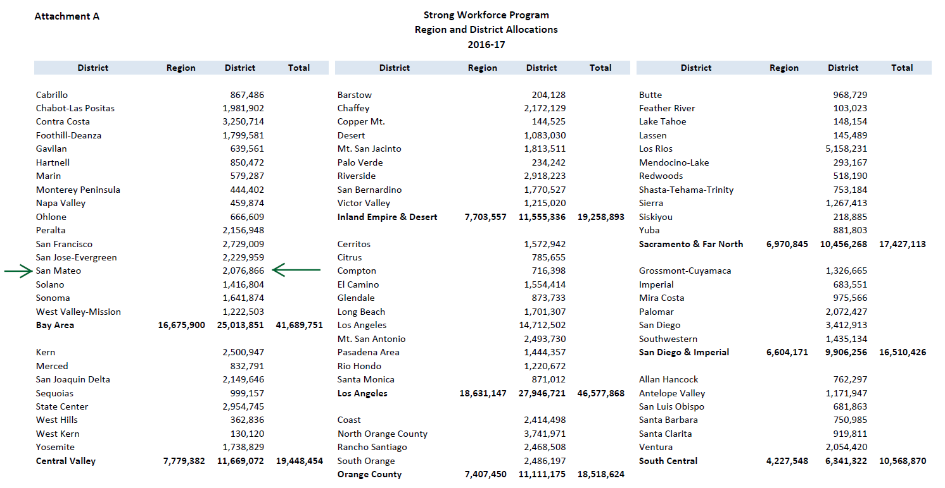
Region and District Allocations 2016/2017

Slide 12
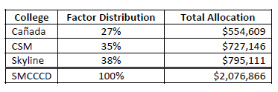
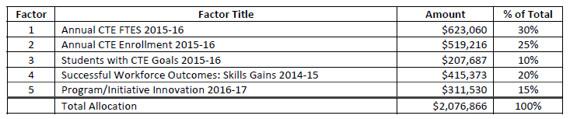
Strong Workforce Fund Distribution - SMCCCD
A full explanation of the distribution, data, and sources is available on the Administrative Services SharePoint site.

Slide 13
Local Plan Elements (Due 1/31/17)
MUST increase the number of students in quality CTE courses, programs, and pathways that will achieve successful workforce outcomes.
MAY invest in new or emerging CTE courses, programs, and pathways that may become operative in subsequent years and are likely to lead to successful workforce outcomes.
MAY Address Strong Workforce Task Force recommendations.
MUST Provide evidence of demand for workers within the funded CTE Program(s) AND
  Identify geography and occupations targeted
  Identify labor market demand and supply gap
  Cite source of labor market information

Slide 14

Local and Regional Share-Timelines
Local Share allocations posted 8/5/16
Board of Governors approval 9/18/16
Local Share Template went live on 9/19/16
OK to spend Local Share as of 9/19/16
Report on uses of funds via Local Share Template
Evidence of labor market demand
Increase quantity/improve quality
District certification
Final date to submit Local Share Template - 1/31/17

Slide 15
Internal Timelines
Workshop for local share application from Faculty on 11/18/16
  REGISTER: https://swpworkshop.eventbrite.com
Plans must be submitted no later than 12/15/16 at 5pm
Feedback, modifications delivered to applicants by 1/17/17
Working draft developed by 1/26/17
Final revisions 1/27/16 - 1/30/17
FINAL SUBMISSION 1/31/17
← STILL ROOM

