Slide 1
2016-2017

Slide 2
What We Do:
Print Advertising: Pole Banners; Bus Ads; Magazine Ads; Mailers; Brochures; Posters
Booklets, Handbooks, Bookmarks, and MANY, MANY MORE!
Catalog/Schedules
Videos/Commercials/Campus Photography
Olive Hill Press
Social Media Campaigns
Board of Trustees Report
Department Branding and Logos
What’s Happening at Cañada
College Presentations
Content Creation and Layout
Event Planning
Department Needs and Web Updates
Community and Media Relations

Slide 3
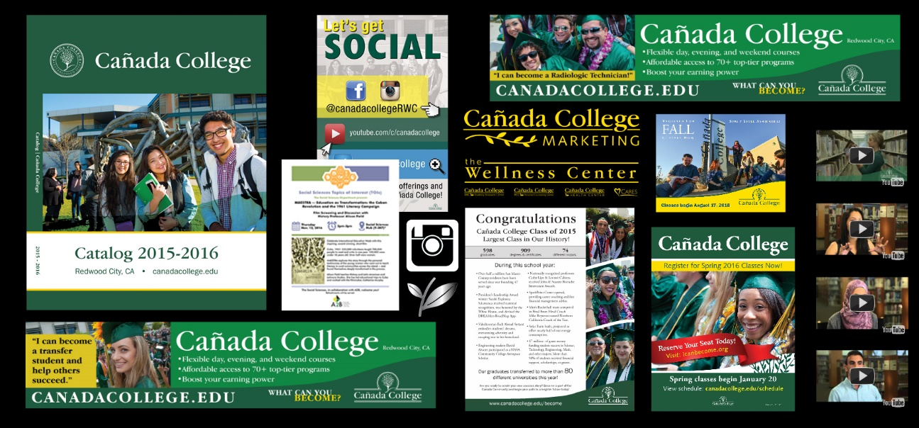
Examples of What We Do

Slide 4
2016-2017 Marketing Plan: Goals
Help key audiences recognize and understand the Cañada College mission and how it plays an integral role in San Mateo County and surrounding communities. This is your hometown college:
Work with faculty, staff and students to develop and implement impactful, cost-effective marketing communication strategies to enhance public awareness of Cañada College as an affordable and quality provider of higher education.
Help to show students the importance of completing their respective goals/programs through student success stories and the #iCAN Become campaign.
Strengthen relationships and increase visibility as a valued partner within the community.
Increase web/social media presence via Cañada website, Blog, Facebook, Instagram, Twitter, Flickr and YouTube by 10 percent in the next 12 months.

Slide 5
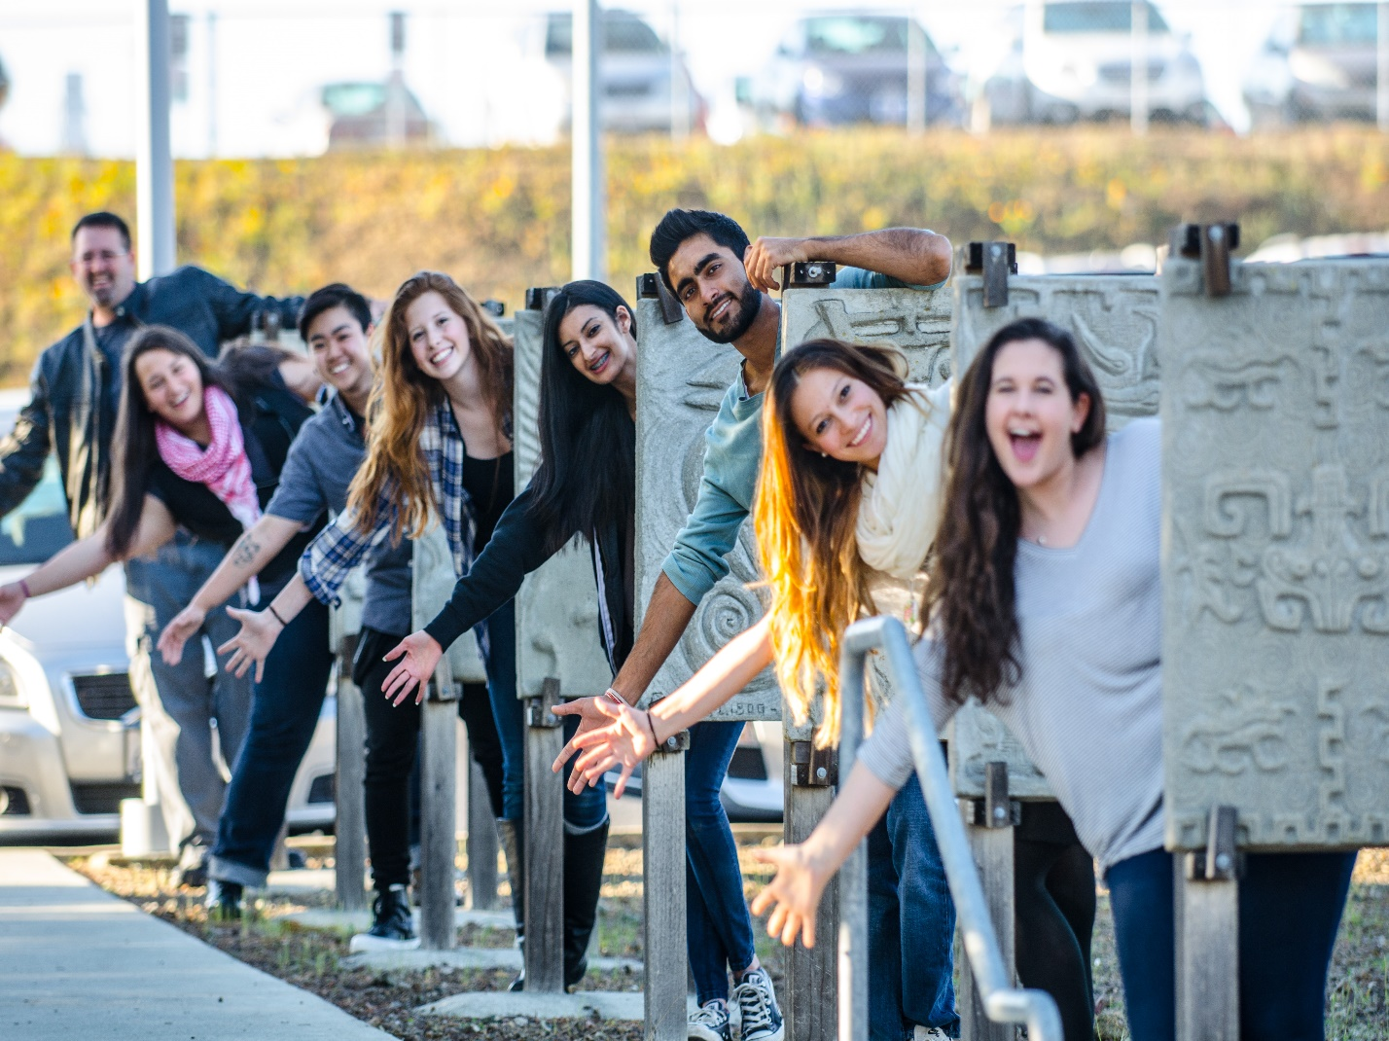
Key Messaging Points
Straight from the student’s mouths…
Smaller, intimate educational environment
for more one-on-one student attention.
2. Level of faculty/staff investment in students.
3. Fun campus activities for students
through clubs, student government and
volunteer opportunities.

Slide 6
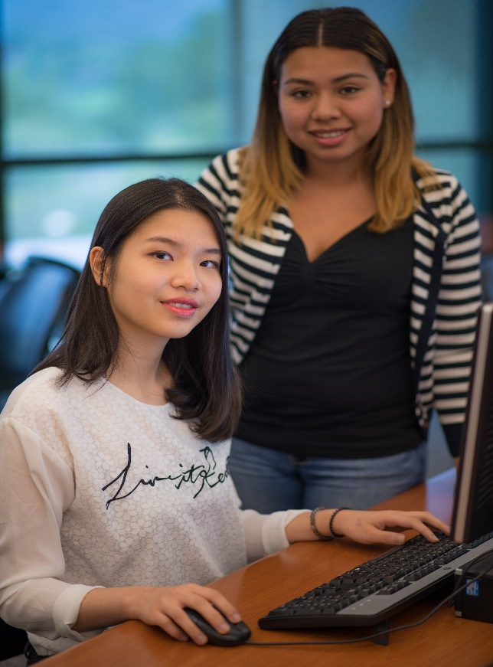
Target Market: Internal/External Audience
Internal Audience:
Students
Faculty
Staff
District/Board of Trustees
External Audience:
International students
Prospective transfer students
Adult School students
Sequoia Adult School
Middle and High Schools: teachers, guidance counselors, administrators
Local/partner Universities
Non-profit Organizations
Parents
Alumni
Donors/Potential Donors
Elected Officials
Residents and Businesses of San Mateo County and surrounding communities

Slide 7
Target Market: External Audience
High School Students:
Redwood City: Sequoia, Woodside, Redwood,
Everest Charter High, Summit
Belmont: Carlmont
Menlo Park: Menlo Atherton
East Palo Alto: EPA Charter, EPA Phoenix Academy
South San Francisco: El Camino, South SF
Half Moon Bay: Half-Moon Bay
Pescadero: Pescadero
San Mateo: Aragon, Hillsdale
Burlingame: Burlingame
San Bruno: Capuchino
Los Altos: Los Altos
Millbrae: Mills
Pacific: Oceana, Terra Nova
Palo Alto: PA, Gunn
Mountain View: Mountain View HS
San Jose: Leigh High School

Slide 8
Goal #1
Work with faculty, staff and students to develop and implement impactful, cost-effective marketing communication strategies to enhance public awareness of Cañada College as an affordable and quality provider of higher education.
Create, distribute and track an electronic survey that will be distributed to the campus community to assess effectiveness of strategies.
Hold quarterly meetings with the newly-formed PROM (Public Relations Outreach Marketing) Advisory Committee to discuss marketing trends, community and media updates and how we can implement them into timely and effective marketing and community outreach strategies.
Work with each division to hold one event per year, showcasing the programs, degrees and certificates offered. Invite past students to attend and share experience with prospective student.
Continue working with students, faculty and staff to develop marketing material (print or electronic) to promote their respective programs, This includes (but is not limited to): videos, advertisements, social media posts, brochures, posters and business cards.

Slide 9
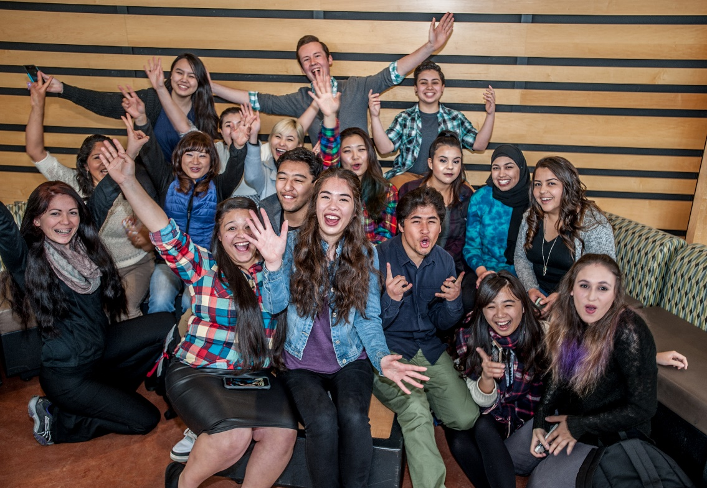
Goal #2
Help to show students the importance of completing their respective goals/programs through student success stories and the #iCAN Become campaign.
Promote and leverage studies and successes of students, faculty and staff through presentations, social media, marketing collateral and media relations.
Proactively pitch newsworthy stories to media as they occur, creating a presence in local media outlets to attract qualified and diverse student population.
Purchase print, web and commercial advertising in local media:
30-second commercials (in English and Spanish)
Bus Ads
Facebook/Instagram
Spectrum Magazine
Climate Magazine
San Mateo Daily Journal
Redwood City Chamber of Commerce Community Guide
Distribute marketing materials to target market: brochures, direct mailers,
schedule, catalogs, giveaways, fact sheets, holiday cards.

Slide 10
Goal #3
Strengthen relationships and increase visibility as a valued partner within the community.
Host lunch presentations with high school guidance counselors and administration, informing them of program updates and educational opportunities for their students.
Bring student athletes and coaches to community and high school events, serving as a “meet and greet” and informational session for prospective student athletes.
Partner with local libraries to host on-site “Connect to Cañada College” Information and Registration sessions.
Partner with local organizations to perform day of service events and activities at least once per quarter to demonstrate that the College is invested in the community that it serves; program is branded as “Cañada in Your Community.”

Slide 11
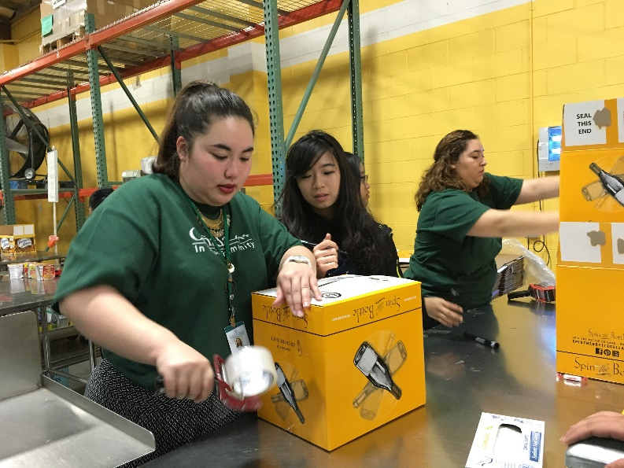
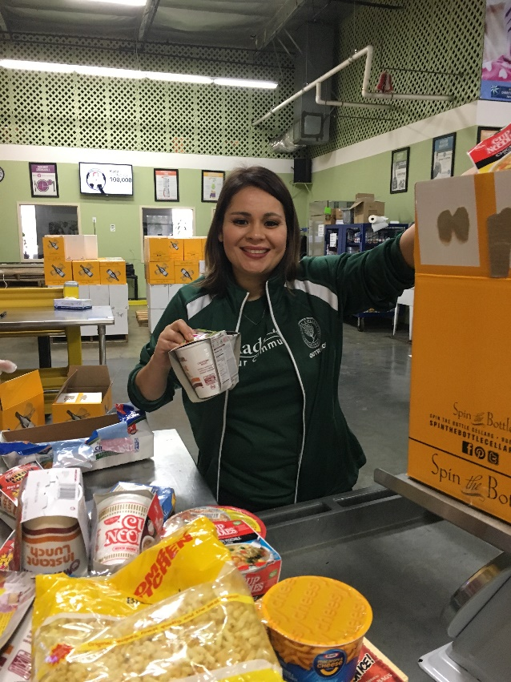
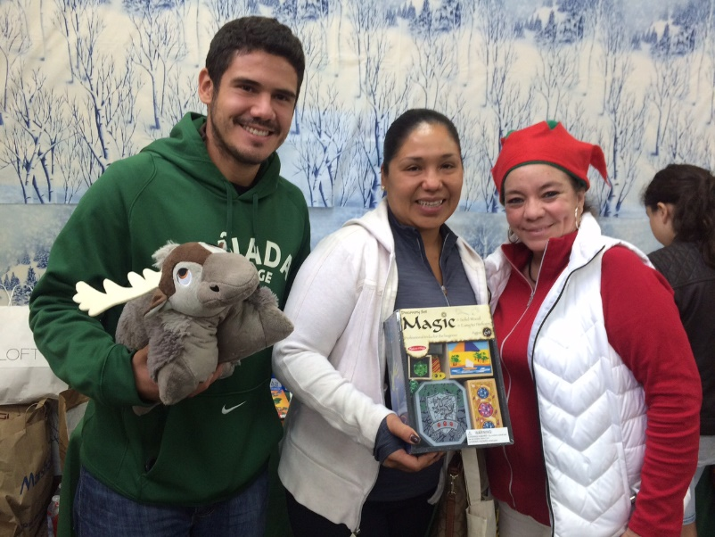
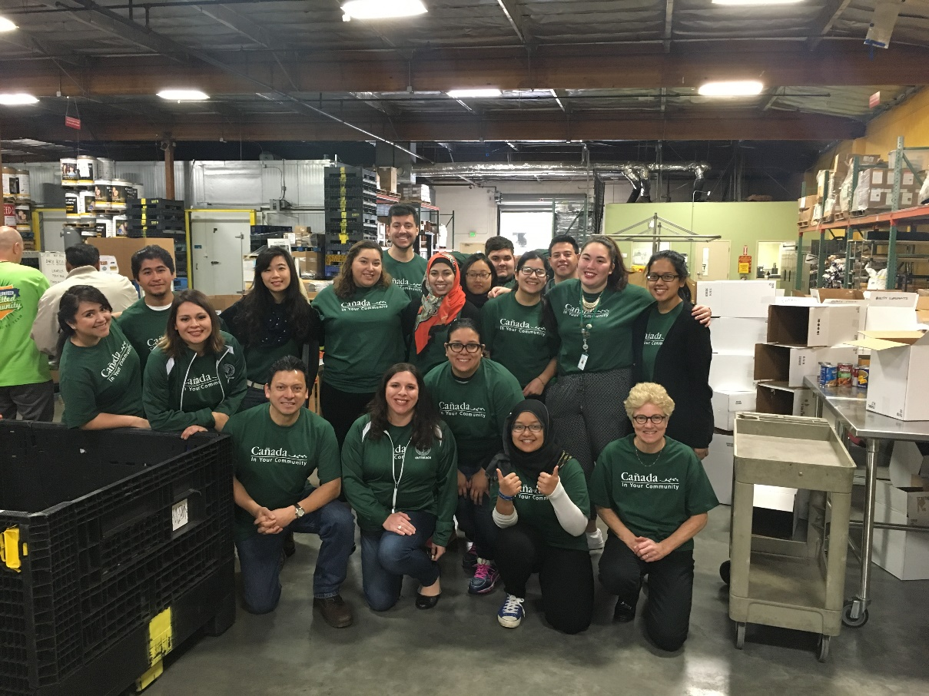
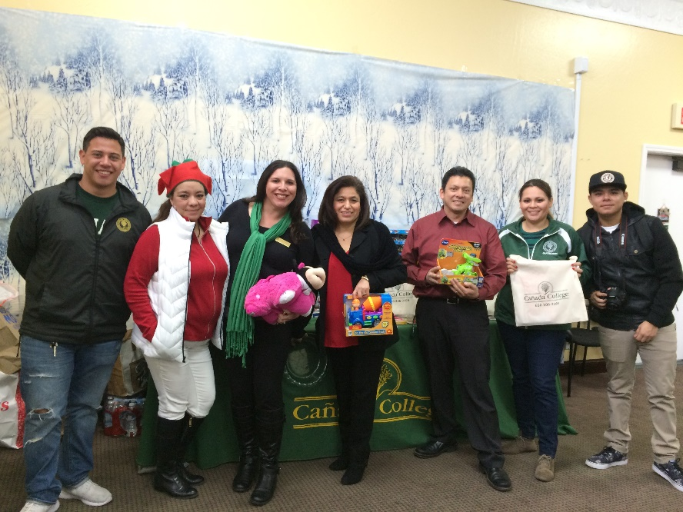
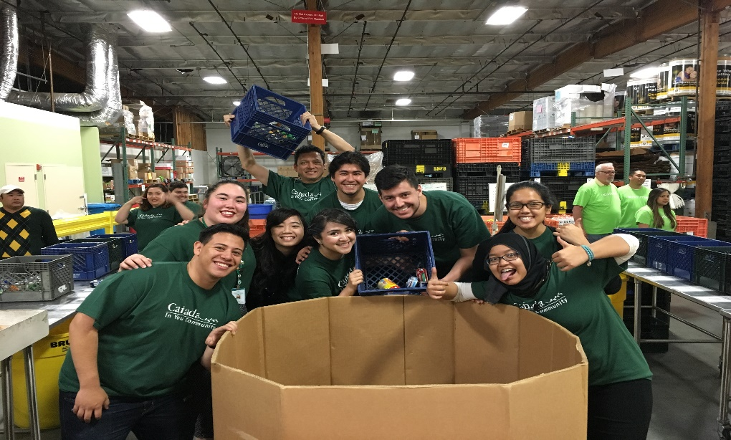
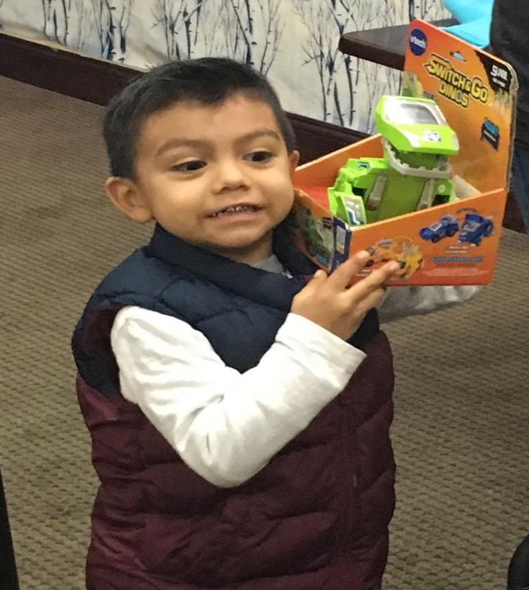
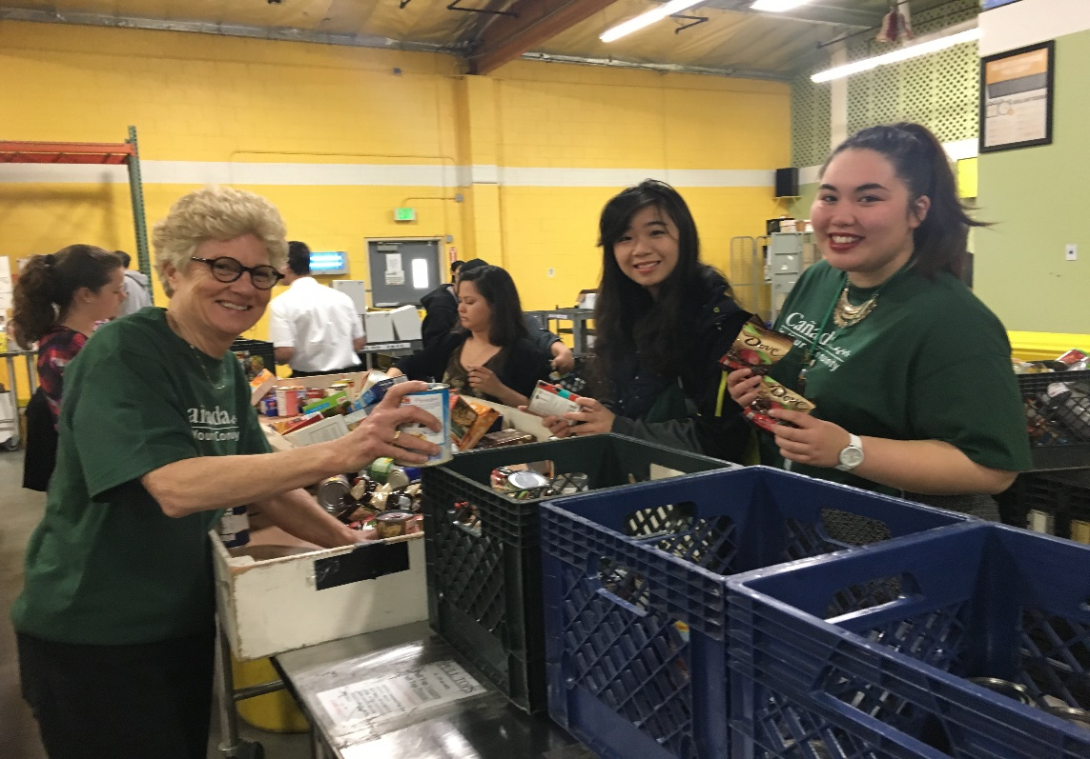
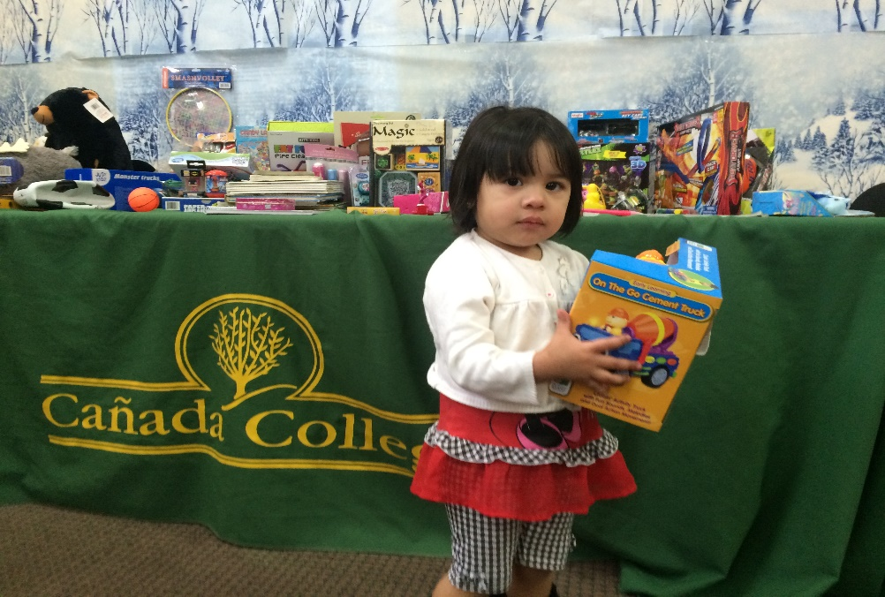

Slide 12
Goal #3
Presence at 60+ community events/festivals, connecting with our community and sharing information on Cañada:
Redwood City:
4th of July Parade
Blues Festival
North Fair Oaks Community Festival
Downtown Salsa Festival
Redwood City Port Fest
RWC Hometown Holidays
RWC Downtown Fiestas Patrias
North Fair Oaks OYE -Youth Conference
Scare on the Square
Lunar New Year Event
Kermes Dia Del Nino
Almost Mother’s Day Kids Concert
Taft Festival
Fiesta Cañada
DREAMers Conference
High School Events:
Sequoia College Night
Menlo Atherton College Night
Redwood High School College Night
South San Francisco College Day
Sequoia High AVID Program Cañada College Presentation
Half Moon Bay High School College Day
Los Altos High School Latino Informational Day
SUHSD ELD Program Cañada College Presentation
Sequoia High ELD Program Cañada College Presentation
Sequoia High School Dreamers Conference
San Mateo County:
Community Resources Festival
Youth Conference
San Mateo:
Pride Festival
San Mateo HS District Community Fair
East Palo Alto:
Las Posadas
Menlo Park:
4th of July Parade
Half Moon Bay/Pescadero:
Healthy Kids Faire
Pumpkin Festival
Kermes- Dia del Niño

Slide 13
Goal #4
Increase web/social media presence via Cañada website, Blog, Facebook, Instagram, Twitter, Flickr and YouTube by 10 percent in the next 12 months.
Continue to build the College’s Blog, Facebook, Instagram, Twitter, Flickr and YouTube pages while driving social media followers to the College website.
Continue sharing on-campus events with the College community via “What’s Happening at Cañada” weekly eblasts; post on social media outlets to spread the information.
Incorporate cost-per-click advertising on Facebook and Instagram to increase enrollment, awareness of campus happenings/offerings and grow our followers.
Continue tracking and testing social media engagement (and followers) by evaluating which posts garner the most attention.
Utilize Google Analytics to measure web traffic on the College website.
Build a responsive website that will be easy to navigate on mobile and tablet devices.

Slide 14
Growth in Social Media
28 percent Facebook increase in last 12 months
Monitor and respond to students question and feedback
React to urgent safety and security matters on campus
Use a tool to leverage awareness of programs and services offered

Slide 15
Social Media Advertising
10,000 Posts Reach!
73 Likes!

Slide 16
Social Media Advertising
44,208 People
Reached!

Slide 17
Action Plan | Timeline
Update general College marketing material; translate in Español to target our growing Hispanic population; Revise Web Español sections | Ongoing
Further showcase student success through the #iCAN Become campaign | Ongoing
Update College Brand/Style Guide | Summer 2016
Create Outreach High School Engagement Plan | Summer 2016
Create College social media guidelines | Fall 2016
Increase our social media following to 10 percent in 12 months. | February 2017
Plan for Cañada College’s 50th anniversary; printed program mailer, webpage, logo, community awareness campaign | Summer/Fall 2017
Create responsive/mobile friendly website | Fall 2017/Spring 2018

