Slide 1
Interior Design/Architecture Program
Program Review
Summary
May 5, 2017

Slide 2
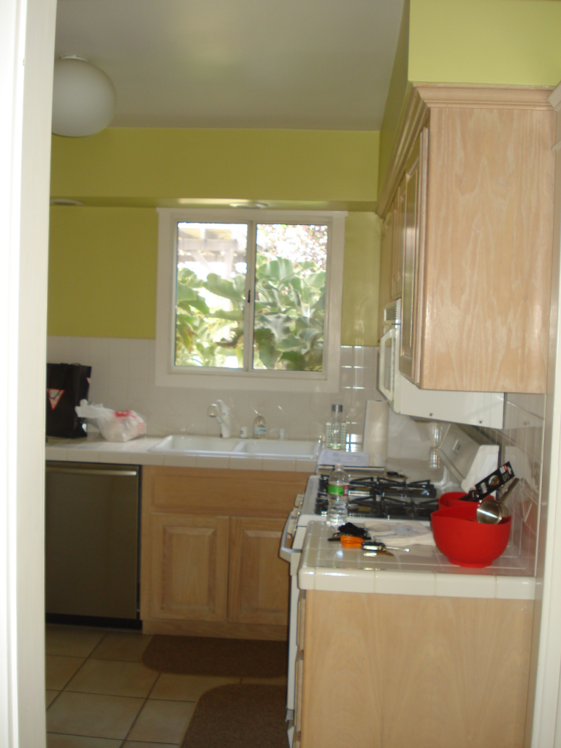
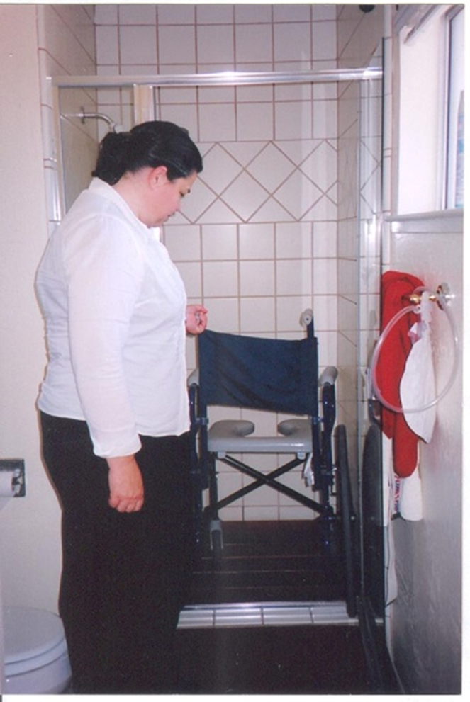
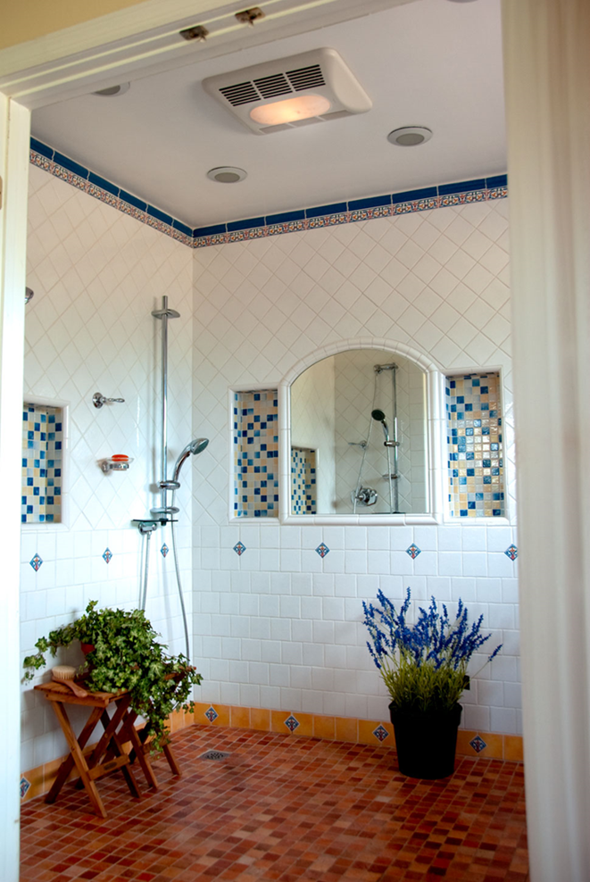

Slide 3
IPC feedback: Executive Summary 1. Strengths of the Program
Comprehensive course & program offerings which prepare students for a variety of jobs in the interior design industry
Three certificates & the AS Degree, including signature programs:
Kitchen & Bath Design Certificate, accredited by NKBA (National Kitchen & Bath Association) – first community college in the country to be accredited
Home Staging Certificate – first in Northern California
Student success & retention rates consistently among the highest at the college – 90 – 91% +

Slide 4
IPC feedback: Executive Summary 1. Strengths of the Program
Experienced faculty team
One full-time Interior Design faculty since Fall 2013 (Dr. Nancy Wolford retired in June, 2013)
Eight part-time faculty members with diverse and complimentary areas of expertise & experience
Active Student Club, Advisory Committee, and volunteers
Regional & statewide recognition as an outstanding Interior Design Program, copied by many

Slide 5
IPC feedback: Executive Summary 1. Strengths of the Program
Hands-on design experience with campus projects:
Lobby Theater, Building 3
Building 18 faculty workroom
Building 22, ECE faculty/students/staff workroom
Dean Heidi’s office, Division of BDW

Slide 6
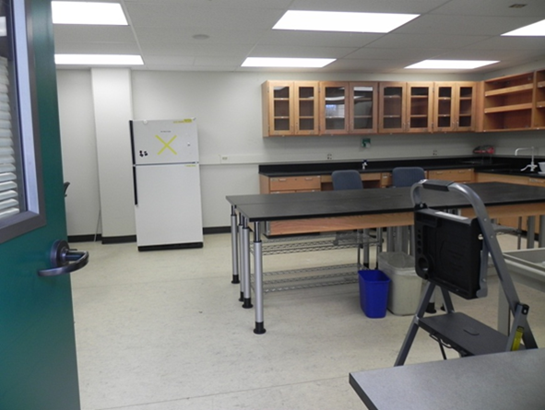
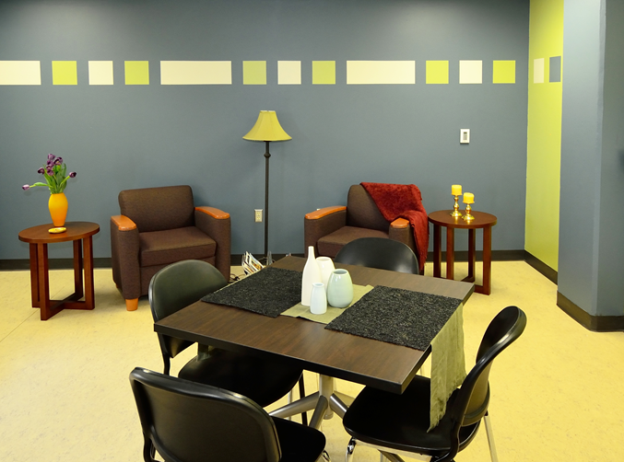
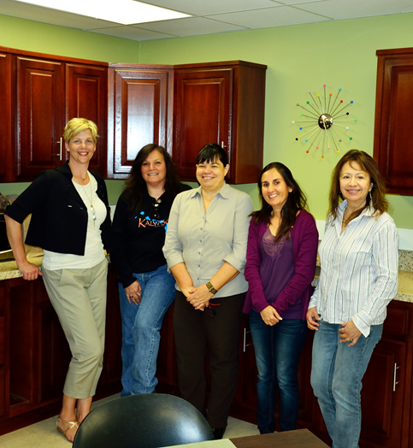
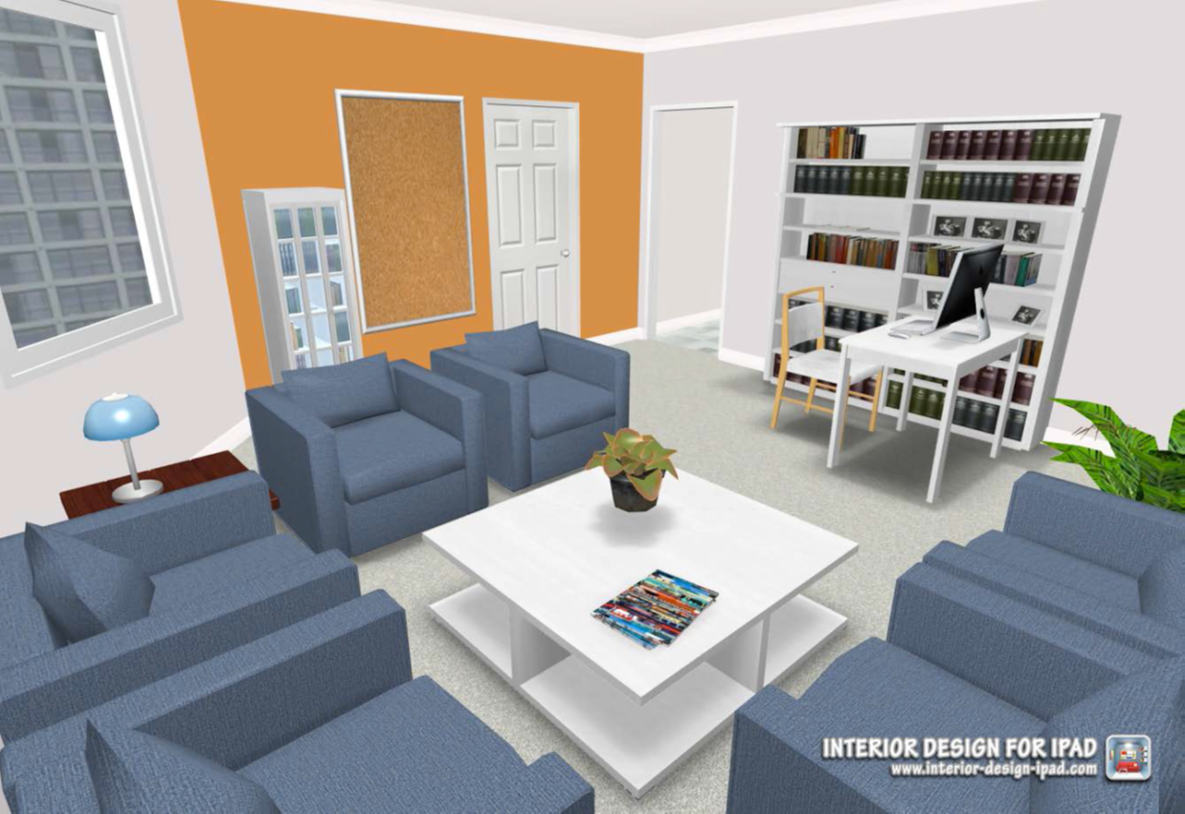

Slide 7
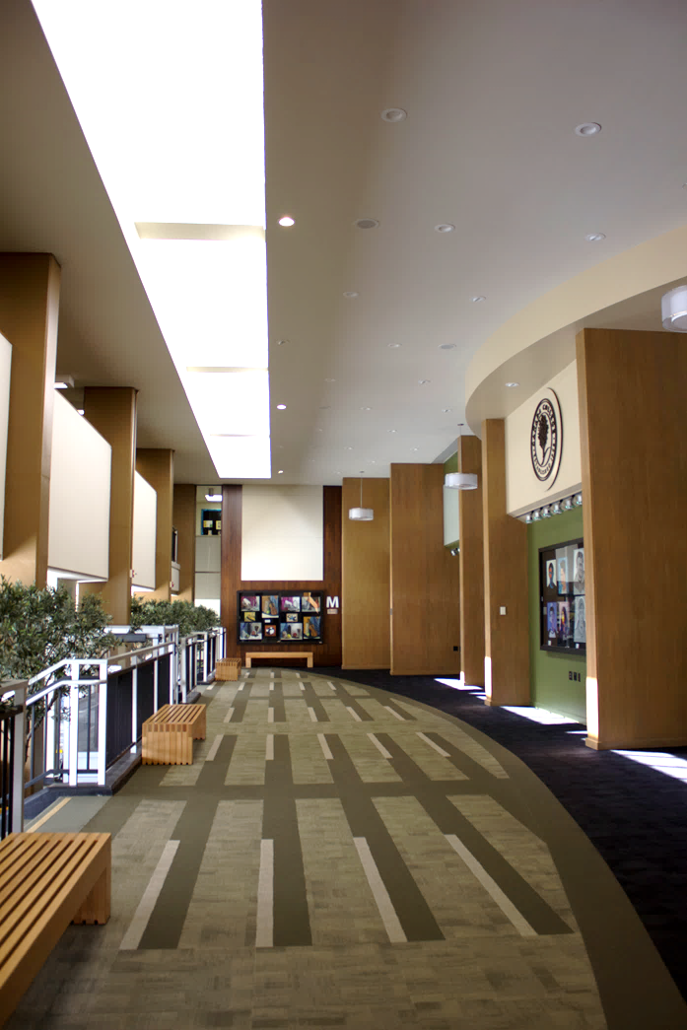
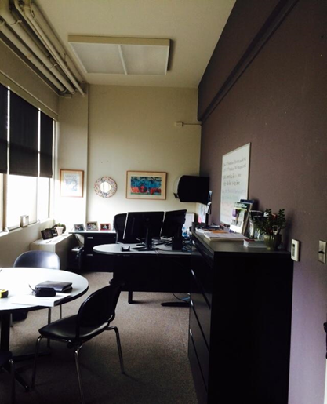
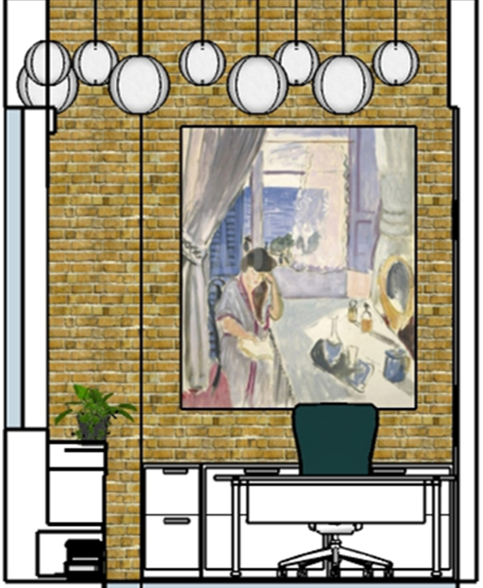
Ronald McDonald House at Stanford
Christmas Tree Elegance Charity Event
ABODE Project in San Jose

Slide 8
Executive Summary
Our standing students/INTD club
Successful practicing & award winning students and graduates
Emmy Awards for Outstanding Achievement in Art Direction
High Tech Companies

Slide 9
Current Challenges
Enrollment
- One significant issue in this analysis is the fact that the maximum enrollment for most of our courses is set between 30 and 45 students. For a CTE program offering specialized courses it is unreasonable to expect sections filled to that level. That is why we strongly recommend the revision of the class size maxima.

Slide 10
Steps
1. Recommending the revision of the class size maxima.
2. Consolidate and streamline the coursework for the completion of the Certificate of Achievements. Effective fall 2017, we will have new changes in our three active certificates with minor reduction in the numbers of units.
3. Keep working and collaborating with the Marketing Department to promote our program. Having a new Director of Workforce will help with this endeavor.
4. Working with San Francisco State University and San Jose State University to establish new articulation path to better serve our students

Slide 11
IPC Feedback: 8A Access and Completion
We have been experiencing an increment in enrollment, specially with introductory courses which are the feeders to our program. An active student club, a new Dean, and a collective effort in promoting our programs have been an integral part in our success. It is also important and critical to highlight the commitment and expertise of our part-time faculty members that makes possible our students success.

Slide 12
IPC Feedback: 9B & 10: SLO Assessment - Impact
It's critical to provide SLO assessment updates into TracDat. The data will help us achieve our accreditation goals.
Need to include a description of your PLO plan as well as next steps.

Slide 13
Thank You!

