Slide 1


Earth Science
We introduce students to the sub-disciplines of Earth Science and to the realm of scientific thinking.
Most students are GE students... often taking their first science course.
Two majors:
  Earth Science AS
  Environmental Science AS (pending)

Slide 2

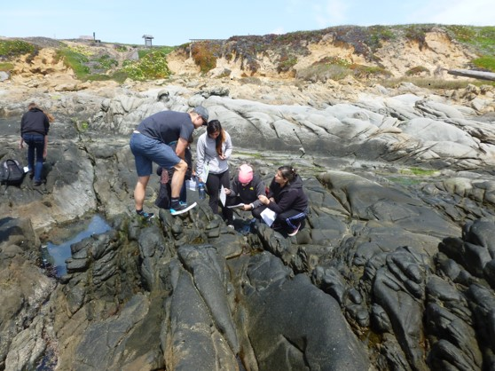
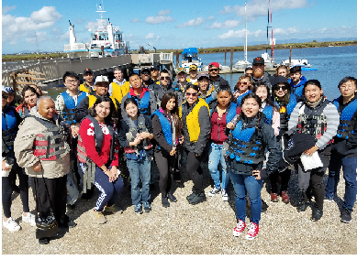
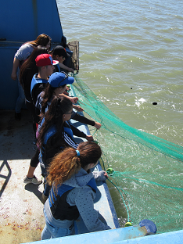
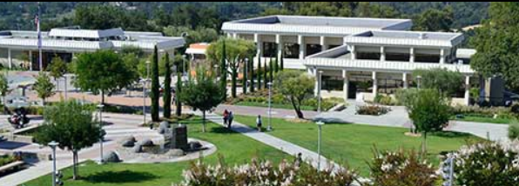
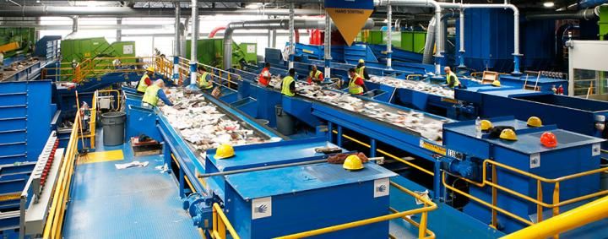

Strengths
Broad range of disciplines offered
  Environmental Science
  Geography
  Geology
  Meteorology
  Oceanography
Opportunities to use remarkable local natural and human resources

Slide 3

Challenges
Underprepared and overextended students.
Small department…. faculty time for:
  Better connections with local resources.
  Better connections with K-12.
  Better connections with local industry to develop CTE.
  More collaboration with other departments and programs..
  More collaboration and communication with adjunct instructors.
  More mentoring of majors students.
  Facilitating research opportunities for students.
  Planning…

Slide 4
Plans for strengthening program
Department Meeting and Training: SLO Assessment, TracDat, etc…
Develop, market, and manage existing degree programs… and create transfer degrees
  Environmental Science AS-T and Geology AS-T
  Develop assessment plan for each program
  On-campus outreach and collaboration
  K-12 outreach and collaboration
Develop better collaboration with other programs to facilitate student success.
Develop and offer more honors courses (duel CRN) to increase student research opportunities.
Strengthen GE Pathways Program (Sustainability)
Research and develop Earth Science CTE Opportunities
  Collaboration with PRIE and Workforce Development.

Slide 5
Plans for strengthening program … and responses to IPC Feedback
Department Meeting and Training: SLO Assessment, TracDat, etc…
Develop, market, and manage existing degree programs… and create transfer degrees
  Environmental Science AS-T and Geology AS-T
  Develop assessment plan for each program
  On-campus outreach and collaboration
  K-12 outreach and collaboration
Develop better collaboration with other programs to facilitate student success.
Develop and offer more honors courses (duel CRN) to increase student research opportunities.
Strengthen GE Pathways Program (Sustainability)
Research and develop Earth Science CTE Opportunities
  Collaboration with PRIE and Workforce Development.

