Slide 1
Internal Scan Part II
Prepared for the Educational Master Planning Task Force
November 3, 2021
Office of Planning, Research & Institutional Effectiveness

Slide 2
Agenda
Quick review of main takeaways from Part I
What can help explain these trends?
Understanding student journeys and changing preferences – what do our students want?
What might be contributing to students not completing their journeys?
How can we best address student needs given our resources/size/location?
How can these factors inform potential goals and strategies?

Slide 3
Enrollment Trend Summary
Cañada’s enrollment continues to decline (COVID exacerbating pre-COVID trends)
Cañada’s share of Full Time Equivalent Students (FTES) is declining faster than at SKY and CSM which impacts the college’s funding
Fewer students are enrolling after applying
Fewer students are seeking a degree, certificate or transfer from Cañada
A greater share of Cañada’s headcount (and enrollments) are coming from SKY and CSM home campus students over time

Slide 4
Student Momentum Summary
BIPOC students continue to be negatively disproportionately impacted in terms of their course success rates at Cañada
This trend is more pronounced in online courses, even as the college is improving its overall online course success rate
Cañada’s implementation of AB 705 is yielding gains for students and is closing access and throughput gaps, but we can do better
While overall persistence rates are improving, Black non-Hispanic students continue to persist at disproportionately lower rates
Special Programs help with persistence and, to some degree, with course success

Slide 5
Student Completion Trends

Slide 6
Current College Mission
Cañada College provides our community with a learning-centered environment, ensuring that all students have equitable opportunities to achieve their transfer, career education, and lifelong learning educational goals. The College cultivates in its students the ability to think critically and creatively, communicate effectively, reason quantitatively, and understand and appreciate different points of view within a diverse community.

Slide 7
Cañada College 2-Year Degree Attainment
‡ The 2019-20 and 2020-21 academic years were impacted by the COVID-19 pandemic and may not be representative of a typical academic year.
Notes:
Percent of degree earners who completed an award in the given time

Slide 8
Cañada College Transfer Rate as of 2020-21
Notes:
Fall first time student cohort 2015

Slide 9
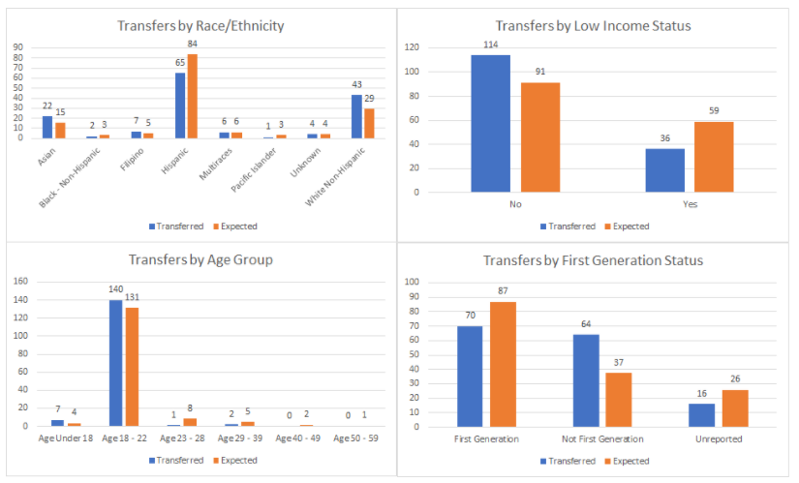
When comparing the subset of students (a cohort that first enrolled in Fall 2015) who transferred within four years of starting to the overall cohort some subgroups are less likely to transfer than others. All of our older students (23+) were less likely to transfer than their younger counterparts. Additionally our Hispanic students were less likely to have transferred than their peers. Low income and first generation student groups were also less likely to transfer than their peers. There was no difference in transfer across gender. Source: Cañada College Transfer Services Plan: 2021-24.

Slide 10
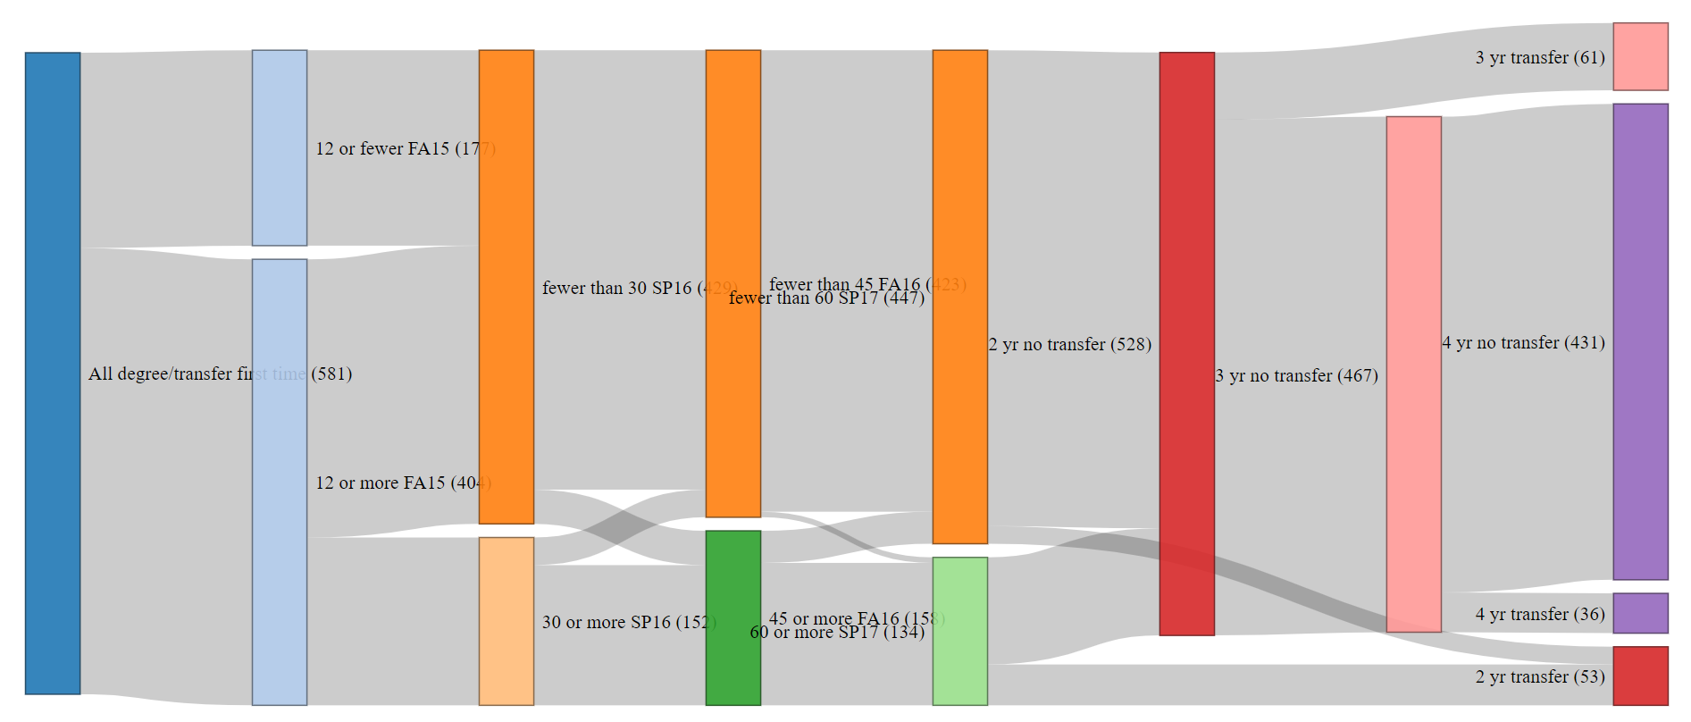
Transfer journey of Fall 2015 first-time cohort

Slide 11
Summary of Student Completion
Cañada is not fulfilling its mission of “ensuring that all students have equitable opportunities to achieve their transfer, career education, and lifelong learning educational goals.”
Hispanic, low income and first generation college students are less likely to transfer than we would expect

Slide 14
Why are these trends happening?
Internal factors
External factors
Our size?
Our location?
Our schedule?
Our choices of instructional modality?
Do students feel sufficiently connected to and supported by the campus? Even online?
It’s really expensive to live here and students work many hours
Students have other obligations beyond working that get in the way of taking more classes (family, care-giving, etc)

Slide 15
Why are these trends happening?
COVID-19 and the increase in online offerings District-wide
Pre-pandemic, CAN could boost enrollment by putting courses online and tapping SKY and CSM students
Changing student preferences
Desire for a mix of in-person and online modalities to help manage their work/school/life balance
SWIRL is more possible
Economic realities: Cañada students (especially part-time students) are working longer hours for pay

Slide 16
Sometimes our challenges are also our strengths
CHALLENGES
STRENGTHS
Small size – can’t offer as many courses and programs
Location – hard to get to
We might not offer enough sections of critical courses to offer them in multiple modalities each term
Small size – intimate, friendly
Location – beautiful campus
We can change our course schedule

Slide 17
Understanding our students’ journeys and shifting preferences

Slide 18
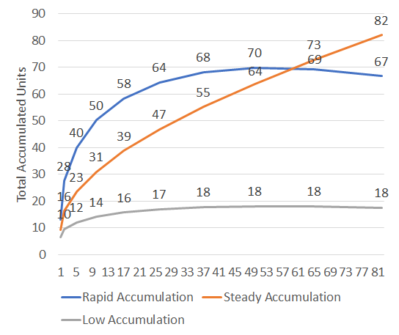
Unit Accumulation Groups in our Fall 2016 First-Time Cohort
Rapid Accumulation
32% of the cohort
Accumulating over 10 units per term
2-3 years to completion
Steady Accumulation
12% of the cohort
Accumulating 7-9 units per term
3-4 years to completion
Low Accumulation
56% of the cohort
Accumulating 0-5 units per term
5+ years to completion

Slide 19
Unit Accumulation Group by Race/Ethnicity
 | Rapid |  | Steady |  | Low
AANAPI | 13% | 21 | 11% | 7 | 6% | 19
Hispanic | 52% | 85 | 61% | 38 | 80% | 237
White Non-Hispanic | 24% | 39 | 21% | 13 | 8% | 23
Black/Multi/Other | 12% | 19 | 6% | 4 | 6% | 17
Notes:
Students in the Rapid Accumulation were more likely to be…
White than Hispanic (11x)
Black or Multiracial than Hispanic (5x)
AANAPI than Hispanic (5x)
…than the low accumulation group

Slide 20
Unit Accumulation Group by Education Goal
Education Goal | Rapid |  | Steady |  | Low
Concurrently enrolled 4-year college student | 1% | 2 | 2% | 1 | 1% | 3
College Preparation |  |  | 3% | 2 | 1% | 2
CTE Cert/Career Development | 1% | 1 | 3% | 2 | 4% | 11
Degree/Transfer | 92% | 151 | 76% | 47 | 52% | 154
Exploratory | 6% | 10 | 16% | 10 | 43% | 126
Notes:
Students in the Rapid Accumulation Group are more likely to be…..
Degree or Transfer seeking (24x)
Ag 20 or younger when they start college (16x)
…than the Low Accumulation Group

Slide 21
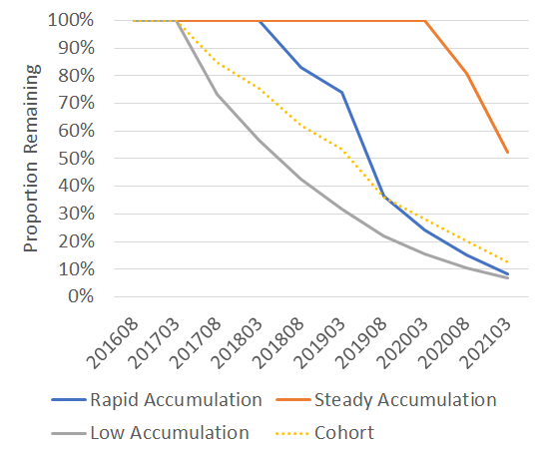
Attrition by Group
The Low Accumulation group show attrition starting in the next primary term.
The Rapid Accumulation group shows attrition after the second year.
The Steady Accumulation group doesn’t show attrition until after the 4th year
After 2 years: | 60% remain
After 3 years: | 20% remain
After 5 years: | 0% obtain a degree or transfer
After 2 years: | 14% obtain a degree or transfer 80% remain
After 3 years: | 46% obtain a degree or transfer 40% remain
After 4 years: | 56% obtain a degree or transfer 15% remain
After 5 years: | 37% obtain a degree or transfer 52% remain

Slide 22
Group Demographic Predictors
Rapid
Low
Students in the Rapid Accumulation Group are more likely to be…..
Degree or Transfer seeking (24x)
Ag 20 or younger when they start college (16x)
White than Hispanic (11x)
Black or Multiracial than Hispanic (5x)
AANAPI than Hispanic (5x)
…than the Low Accumulation Group
Notes:
Students in the Rapid Accumulation Group are more likely to be…..
Degree or Transfer seeking (24x)
Ag 20 or younger when they start college (16x)
White than Hispanic (11x)
Black or Multiracial than Hispanic (5x)
AANAPI than Hispanic (5x)
…than the Low Accumulation Group
There are no significant demographic differences betweem the Rapid and Steady Accumulation Groups

Slide 23
Group Demographic Predictors
Steady
Low
Students in the Steady Accumulation Group are…..
7.3 times more likely to be White than Hispanic
…than the Low Accumulation Group

Slide 24
Breakout Group Discussion

Slide 25
Breakout Group Discussion Prompts
Many degree and transfer-seeking students attempt and earn a very low number of units during their first term. How can we better understand the experience of these part-time students during their first semester?
Are there strategies we are currently pursuing as a college that could better support part-time students? (e.g., Interest Area Success Teams, expanding the College for Working Adults, others?)
What else would you like to know as we consider which strategies might be most impactful for the low unit accumulation (part-time) group? The steady accumulation (part-time) group?
What strategies might be good to help increase or maintain full-time student numbers?
Is there a different interpretation of any of the data presented in today’s slide? Other lines of inquiry you would like to pursue?

